Slide 1
Chapter 10
Cell Immortalization（永生） and Tumorigenesis (肿瘤发生)
Nov 29, 2023
In this chapter, we explore the nature of the regulatory machinery that limits cell proliferation and how it must be neutralized in order for cells to become fully neoplastic（肿瘤的）and form clinically detectable tumors.
Notes:
前面几章分别讲述oncogene, tumor suppressor。接下来几章讲细胞癌变以及组织癌变的 分子历程，今天主讲细胞永生化，这是细胞癌变的一个关键。

Slide 2
Outline of this lecture
1, Hayflict limit and cell immortalization;
2, Barriers of cell immortalization: senescence and crisis;
3, Telomere (history, structure, function);
4, Consequence of telomere loss (BFB cycle);
5, Telomere maintenance mechanisms (Telomerase dependent and independent)
Notes:
本节课内容比较杂，但是重点在此

Slide 3
10.1 Normal cell populations register the number of cell generations separating them from their ancestors in the early embryo
Notes:
正常体细胞的分裂增殖代数是有限的，其中控制因素/机制是什么？

Slide 4
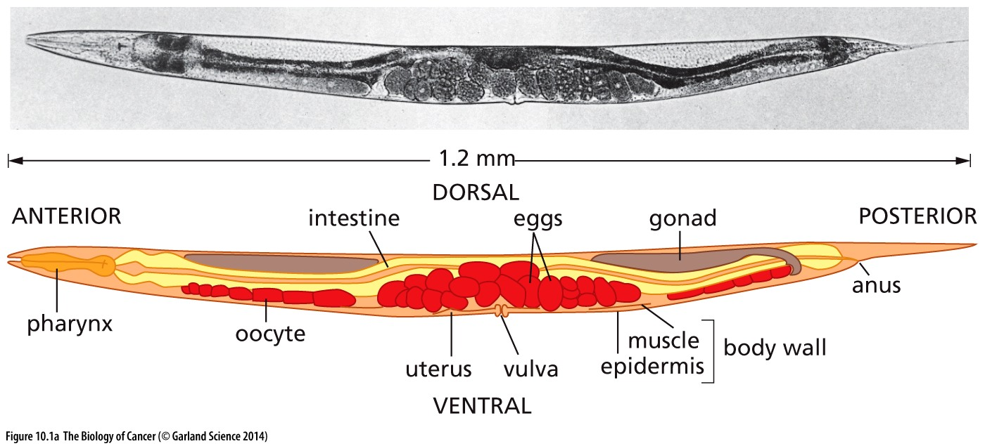
Figure 10.1 The pedigree of cells in the body of a worm
The adult worm Caenorhabditis elegans（线虫） is composed of 959 somatic cells, and the lines of descent of all cells in this worm have been traced with precision back to the fertilized egg.

Slide 5
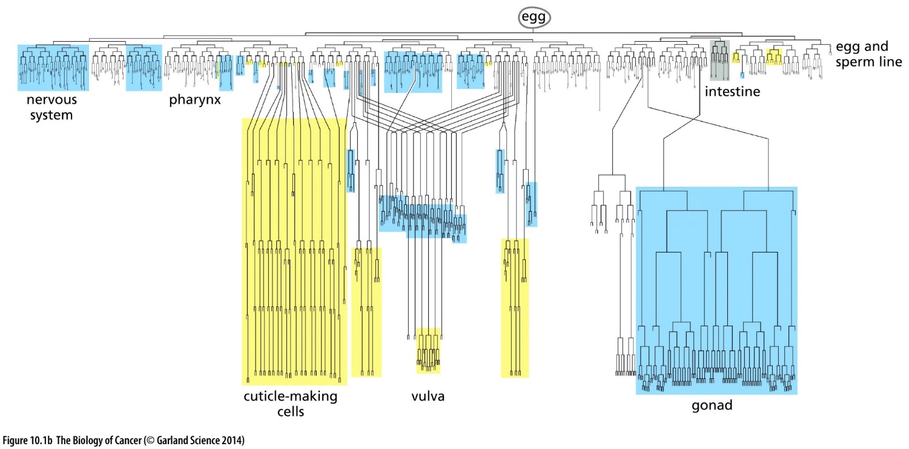
Figure 10.1 The pedigree of cells in the body of a worm
As is apparent, many of the cell lineages end abruptly because cells stop proliferating or are discarded (usually by apoptosis). The cells in each of the major branches are destined to form a specific tissue. For example, cells in the major, multigenerational branch on the right are destined to form the gonads, while those in a small branch at the far left will form the nervous system. (A, from J.E. Sulston and H.R. Horvitz, Dev. Biol. 56:110–156,1977.
Notes:
以线虫为例，正常体细胞的增值分裂次数是有限的

Slide 6
Hayflick limit
Hayflick limit is the number of times a normal human cell population will divide in culture until cell division stops.
The concept of the Hayflick limit was advanced by Leonard Hayflick in 1961
Hayflick limit: ~ 60 divisions
Significance of Hayflick limit:
Prior to Hayflick's discovery, it was believed that normal vertebrate cells are immortal, as suggested by Nobel laureate Alexis Carrel.
Notes:
任何学术观点的意义必须站在时代背景去考虑。1961年以前，学术界主流观点认为：所有细胞都是永生的。普通单细胞微生物固然是永生的，动物细胞当时也被认为是永生的。

Slide 7
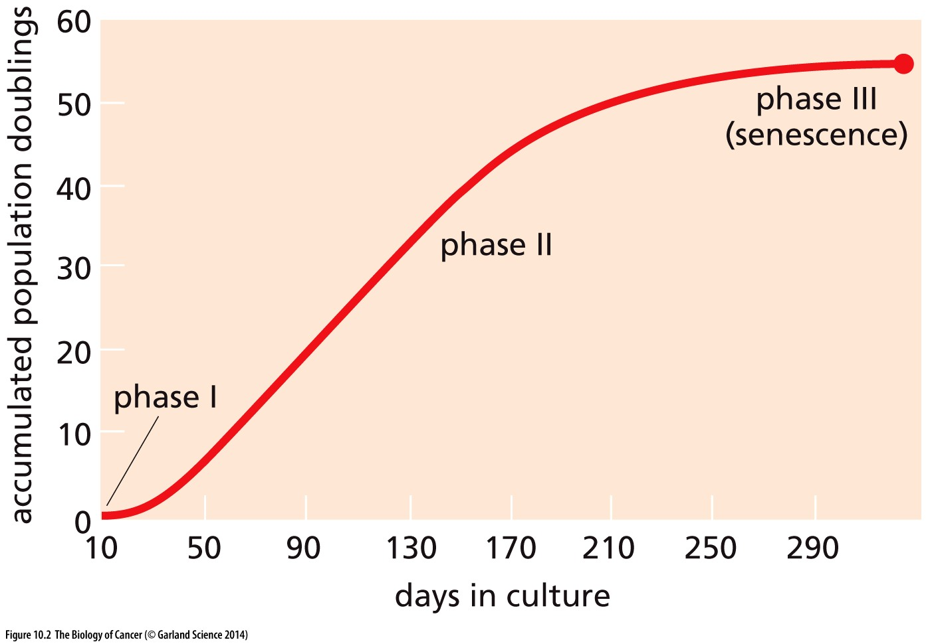
Figure 10.2 The proliferative capacity of cells passaged extensively in culture
The ability of human fibroblasts to proliferate in culture was gauged in Leonard Hayflick’s work by counting the number of times that the population of cells had doubled (ordinate). As is apparent, these cells, beginning soon after explantation from living tissue into culture (phase I), were able to proliferate robustly for about 60 doublings (phase II) before entering into senescence (phase III), in which state they could remain viable but nonproliferating; such senescent cells could remain viable for as long as a year.

Slide 8
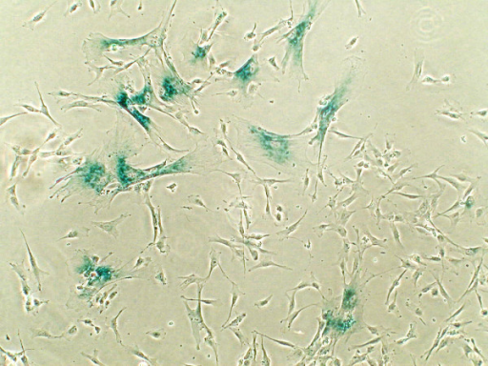
Marker for cellular senescence:
senescence-associated β-galactosidase (SA-β-gal)
Its existence was proposed in 1995 by Dimri et al. following the observation that when beta-galactosidase assays were carried out at pH 6.0, only cells in senescence state develop staining
Dimri GP, Lee X, Basile G, Acosta M, Scott G, Roskelley C, Medrano EE, Linskens M, Rubelj I, Pereira-Smith O (September 1995). "A biomarker that identifies senescent human cells in culture and in aging skin in vivo". Proc. Natl. Acad. Sci. U.S.A. 92 (20): 9363–7.
SA-β-gal is the most common marker for senescence
Its expression is not required for senescence. Nevertheless, it remains the most widely used biomarker for senescent and aging cells, because it is reliable and easy to detect.
Typical SA-β-gal staining
Notes:
Mechanism and implication of cell senescence is still not well known

Slide 9
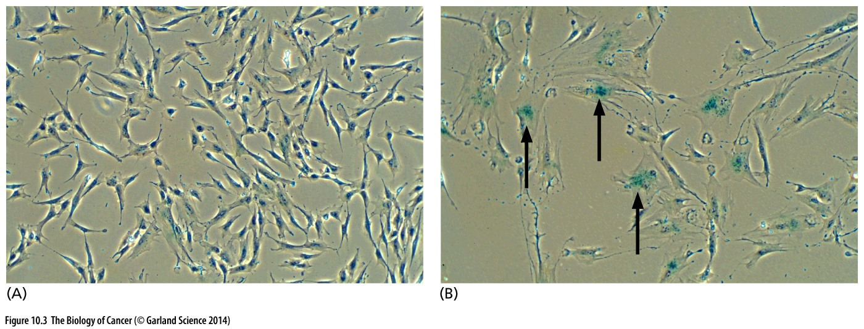
Figure 10.3 Senescent cells arising in vitro and in vivo
Once cells enter into senescence, they cease proliferating but remain viable. Many develop extremely large cytoplasms, giving them a “fried egg(荷包蛋)” appearance. (These two micrographs were produced at the same magnification.) In addition, senescent cells characteristically express acidic β-galactosidase enzyme, which can be detected by supplying them with a substrate that turns blue upon cleavage by this enzyme (arrows.

Slide 10
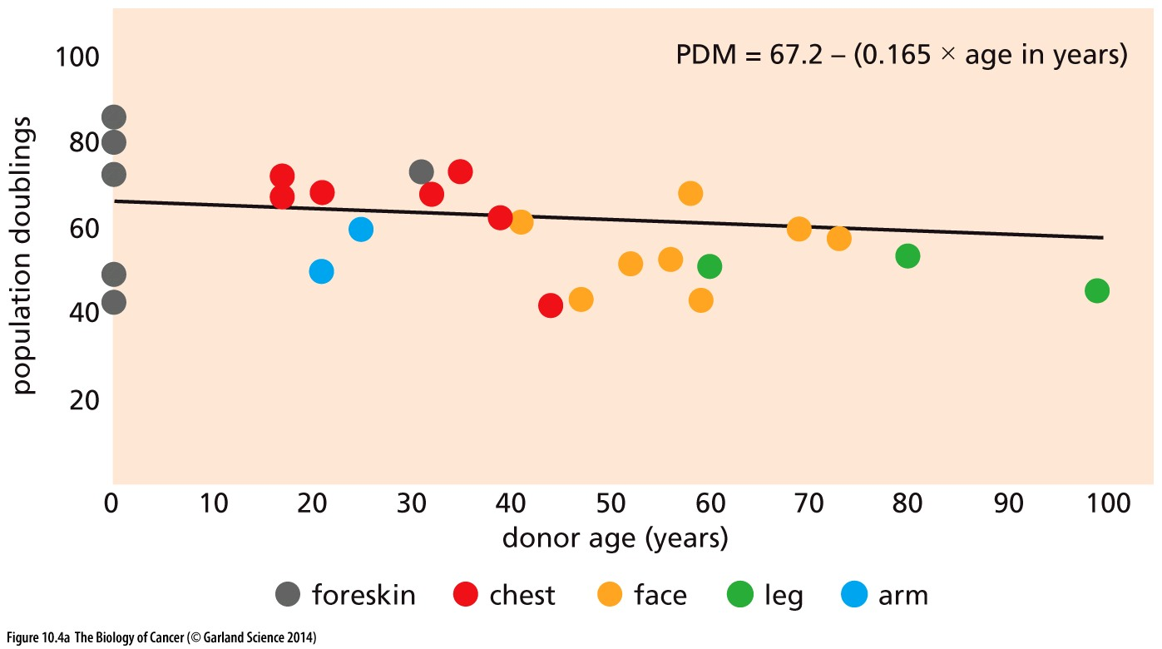
Figure 10.4 Loss of proliferative capacity with age
Cells from older individuals have already used up part of their allotment of replicative doublings prior to being introduced into tissue culture.
(A) The proliferative capacity of cells can be gauged by determining the number of times they will double in culture (mean population doublings, PDM). Here, doublings of dermal fibroblasts from various anatomical sites were measured as a function of the age of the donors.

Slide 11
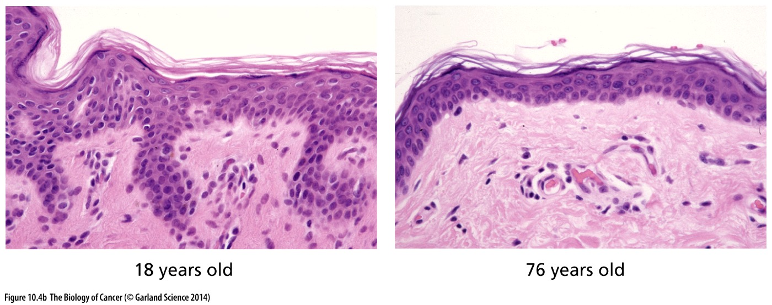
Figure 10.4 Loss of proliferative capacity with age
As the keratinocyte stem cells in the skin lose proliferative capacity with increasing age, the overall ability of the skin to regenerate itself declines, leading to a thinning of the keratinocyte layer of the skin (dark pink) and a loss of the ridge architecture seen in the younger skin. The sun-protected skin of an 18-year-old female (left) is compared here with that of a 76-year-old female (right).

Slide 12
Immortal (永生) cells
Normal cells can be immortal cells, for example: Embryonic stem cell.
Generally speaking, Cancer cells are immortal, but not all immortal cells can be cancer cells.
First immortal cell line: HeLa cells was derived in 1951 from an unusual, particularly aggressive cervical adenocarcinoma discovered in Henrietta Lacks, a young woman in Baltimore.
Notes:
今天的主要内容是：细胞永生。永生细胞的特征？ 那些细胞具有永生特征？目前观点认为癌症细胞具有永生特征。除此以外，某些正常细胞也具有永生特征

Slide 13
10.2 Cancer cells need to become immortal in order to form tumors
Notes:
永生是癌症细胞的一个特征，当然仅仅具有永生特征对癌症发生还是不够的

Slide 14
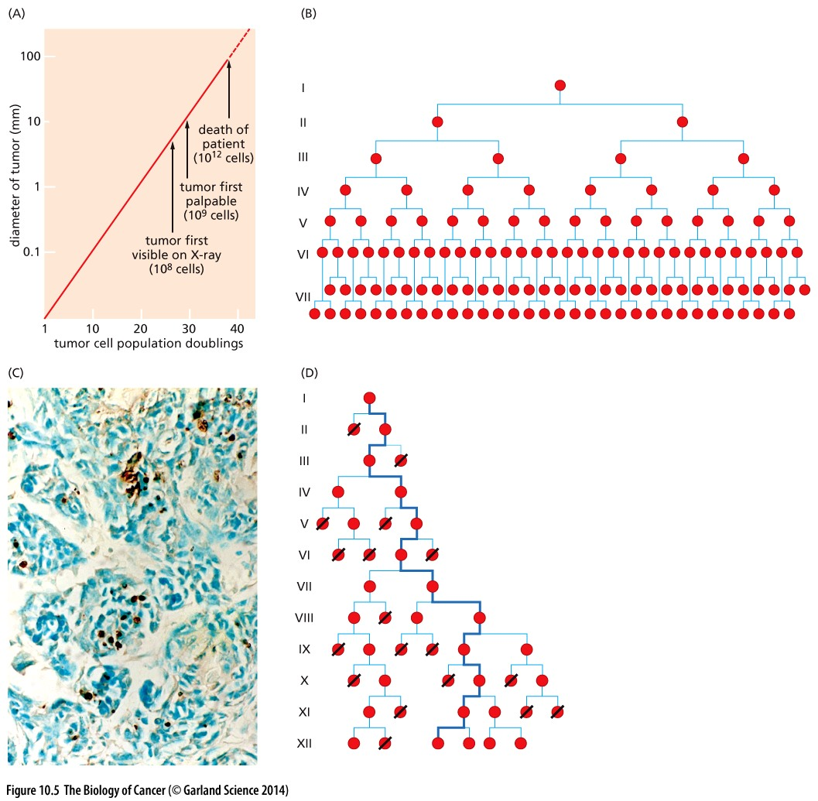
Figure 10.5 Generations of cells forming a tumor mass
B: Theoretical cancer formation model;
D: Actual cancer formation model;
Hayflick limit: ~ 60 divisions
How many divisions are required to form a lethal tumor?
A lethal tumor ~ 10³ cm³ ~ 10¹² cells
Based on B : 40 divisions
Based on D: ~ 70 divisions
Conclusion: Cancer cell need to break Hayflick limit and become immortal.

Slide 15
What is the nature of “generation clock ” observed in primary cells?
1, cumulative physiologic stress; cellular senescence
2, telomere based mechanism; crisis and apoptosis
Notes:
就是回答为什么原代细胞体外培养存在所谓“Hayflick limit”？

Slide 16
10.3 Cell-physiologic stresses impose a limitation on replication

Slide 17
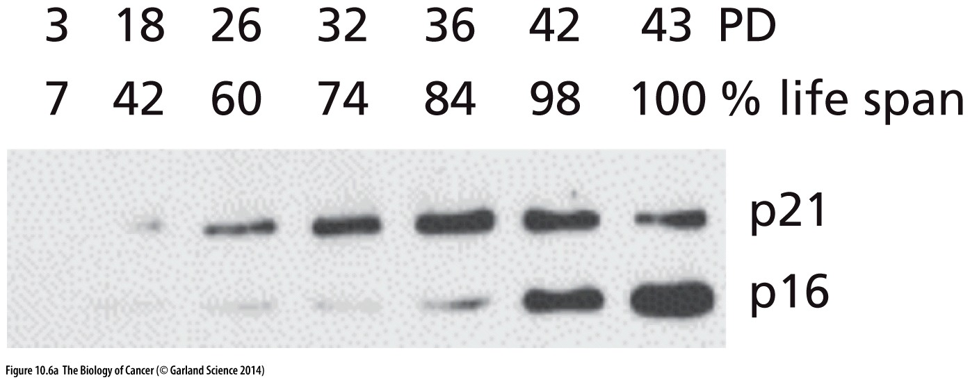
Figure 10.6 Expression of CDK inhibitors during extended in vitro culture
When adult human endometrial fibroblasts are propagated in vitro, expression of both the p16^{INK4A} and p21^{Cip1} proteins (see Section 8.4) is induced, albeit with distinct kinetics. These cells have an expected life span of 40 to 43 population doublings (PD) in culture, whereupon they enter into senescence.

Slide 18
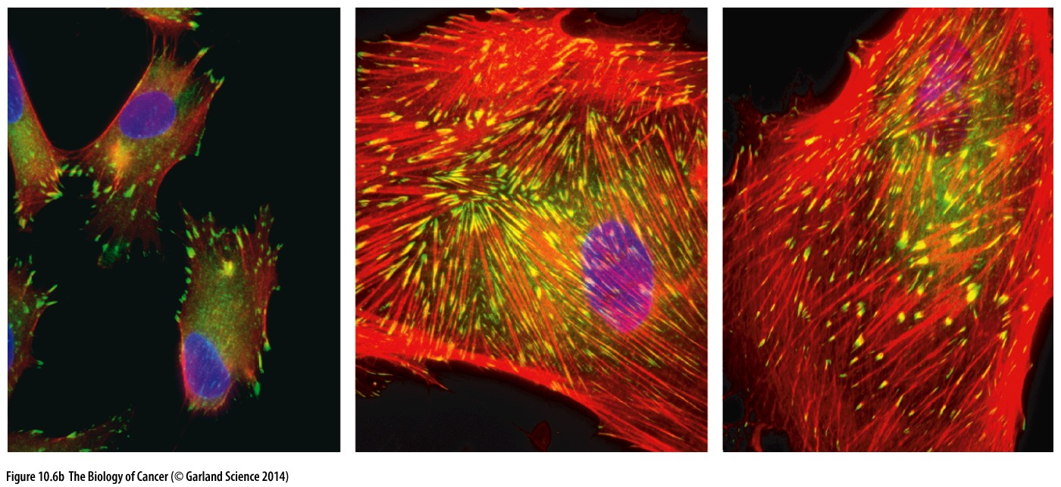
Figure 10.6 Expression of CDK inhibitors during extended in vitro culture
Normal cells (left) are relatively small and have few focal contacts with the substrate (yellow) and few actin stress fibers (orange), in contrast to senescent cells (middle and right).

Slide 19
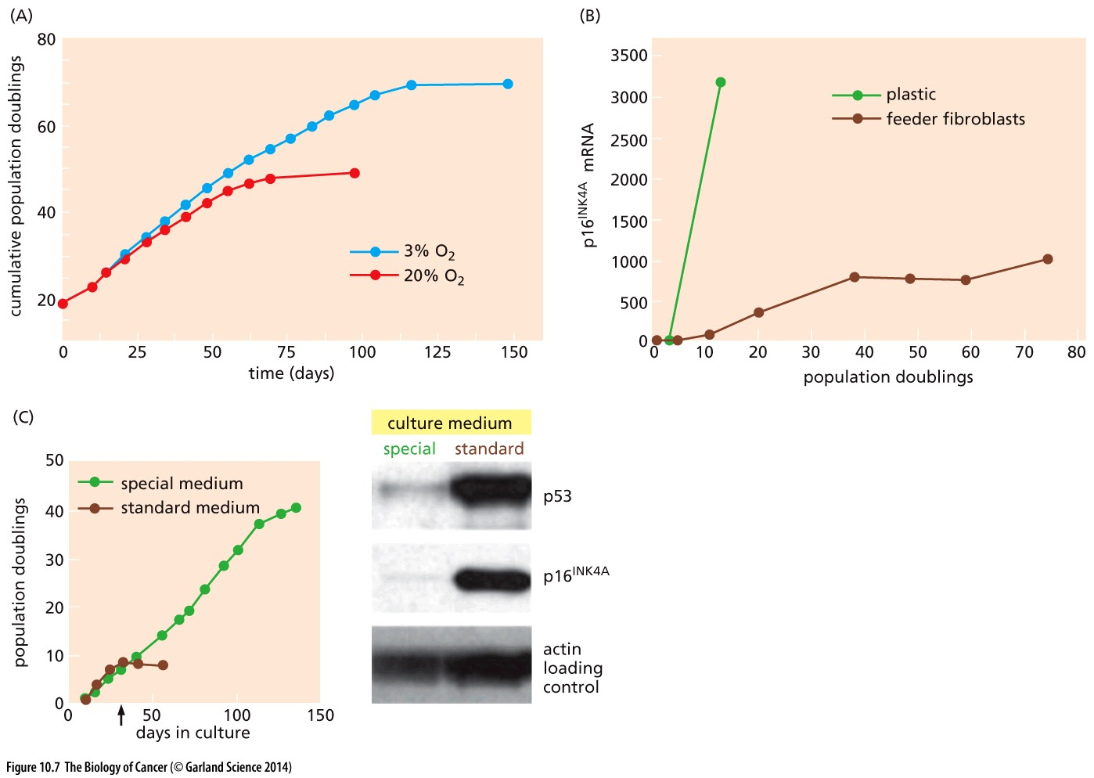
Figure 10.7 Influence of culture conditions on the onset of senescence

Slide 20
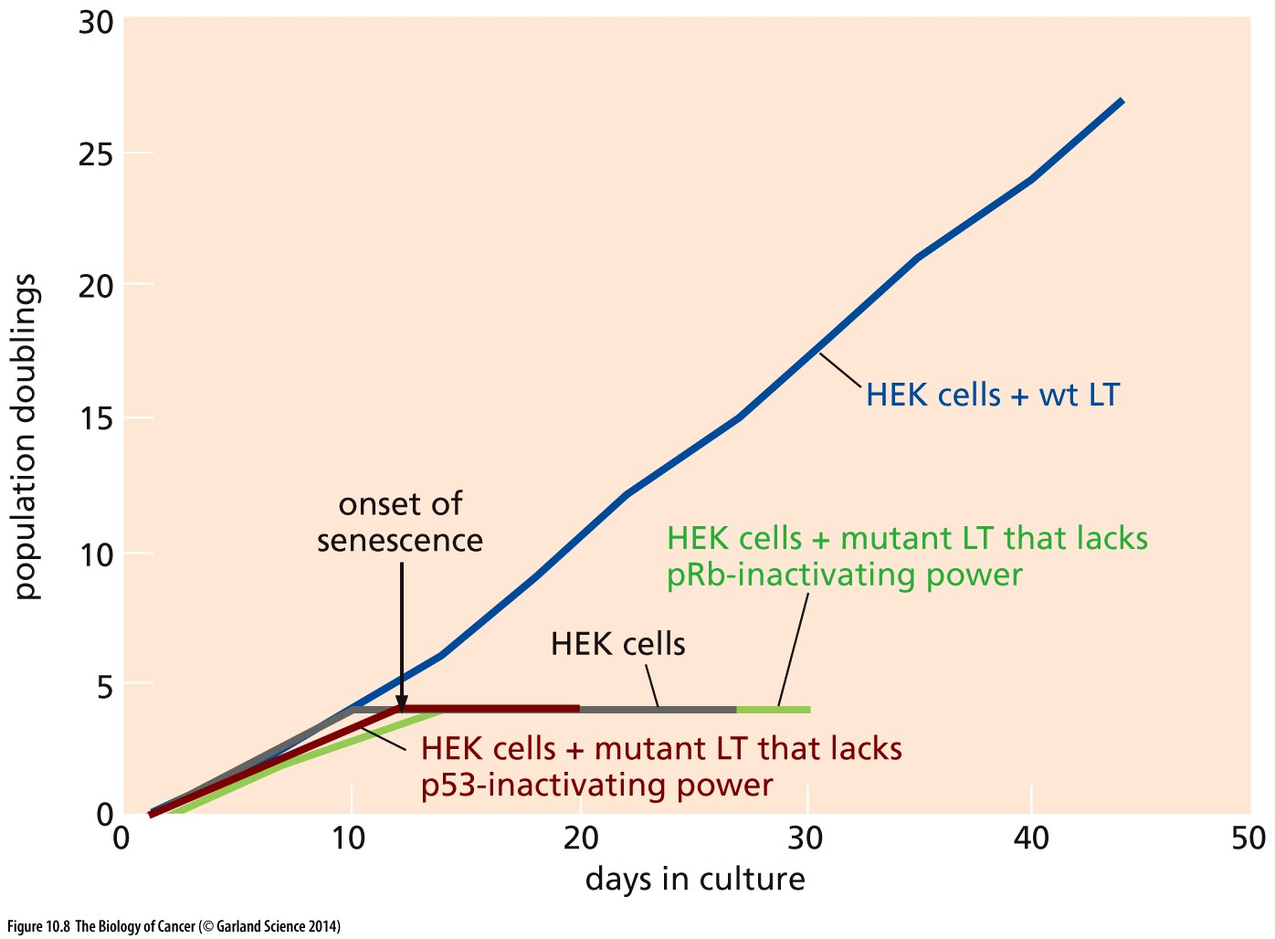
Figure 10.8 Role of large T antigen in circumventing(避免) senescence
human embryonic kidney (HEK) cells
large T antigen(大T抗原) inactivate both p53 and pRb

Slide 21
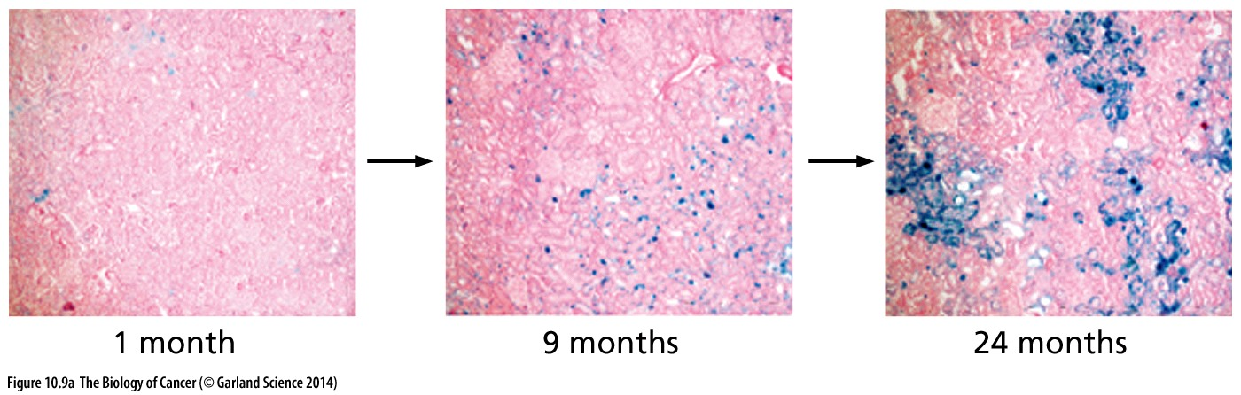
Figure 10.9 Evidence of senescent cells in living tissues
Kidney tissue from rats of the indicated ages was stained for the presence of senescence-associated β-galactosidase (SA-β-gal; blue). Observations like these indicate that normal aging is accompanied by increasing numbers of senescent cells within tissues.

Slide 22
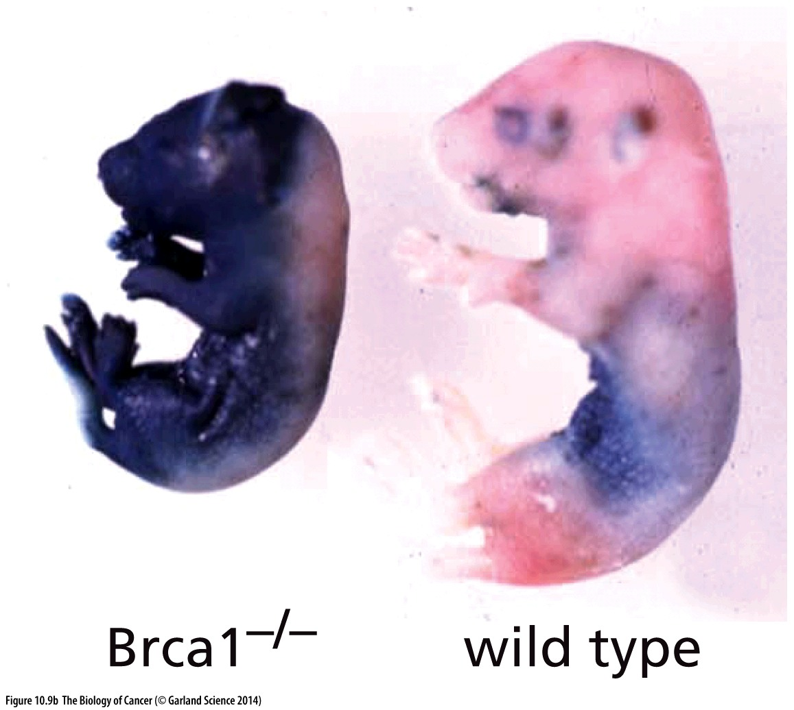
Figure 10.9 Evidence of senescent cells in living tissues
The cells of mouse embryos that are homozygous mutants (left) at the Brca1 locus, which is involved in maintaining genomic integrity (see Section 12.10), suffer extensive genomic damage. These cells register as senescent (blue) when assayed for the SA-β-gal enzyme (see Figure 10.3), in contrast to wildtype embryos (right), where such widespread presence of such senescent cells is not apparent.

Slide 23
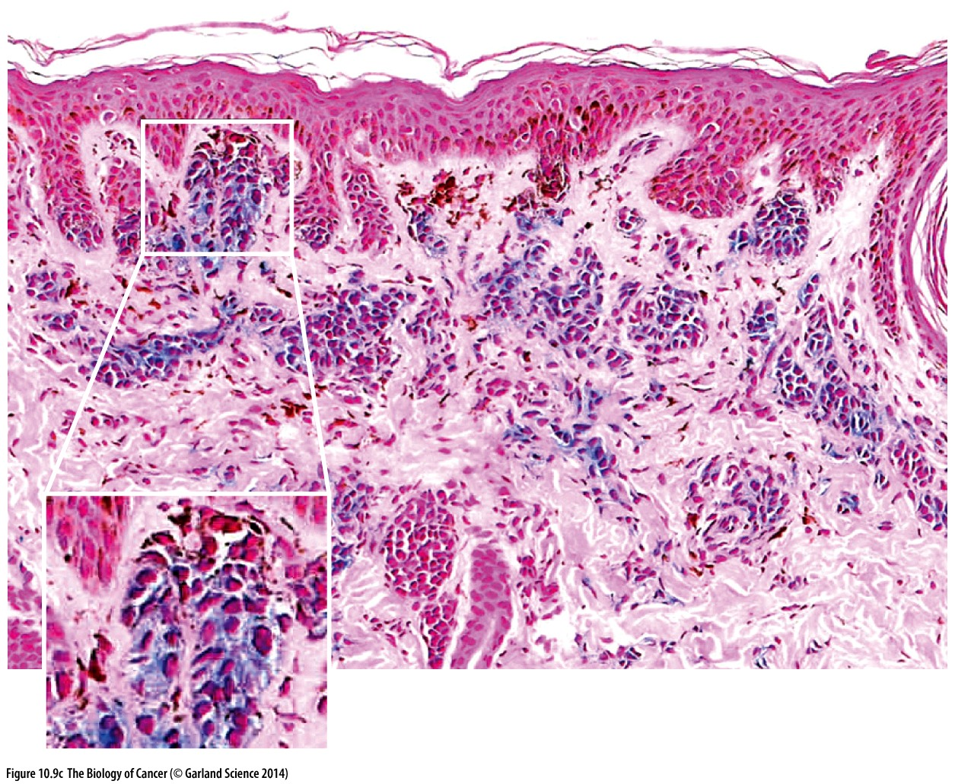
Figure 10.9 Evidence of senescent cells in living tissues
The presence of senescent human melanocytes within dysplastic nevi (benign precursors of melanomas) can also be demonstrated by staining for SA-β-gal (blue; see inset). This suggests that pre-neoplastic cells enter into senescence, ostensibly because of deregulation of their normal signaling circuitry.
Notes:
Senescence也是肿瘤发生的一个天然阻碍

Slide 24
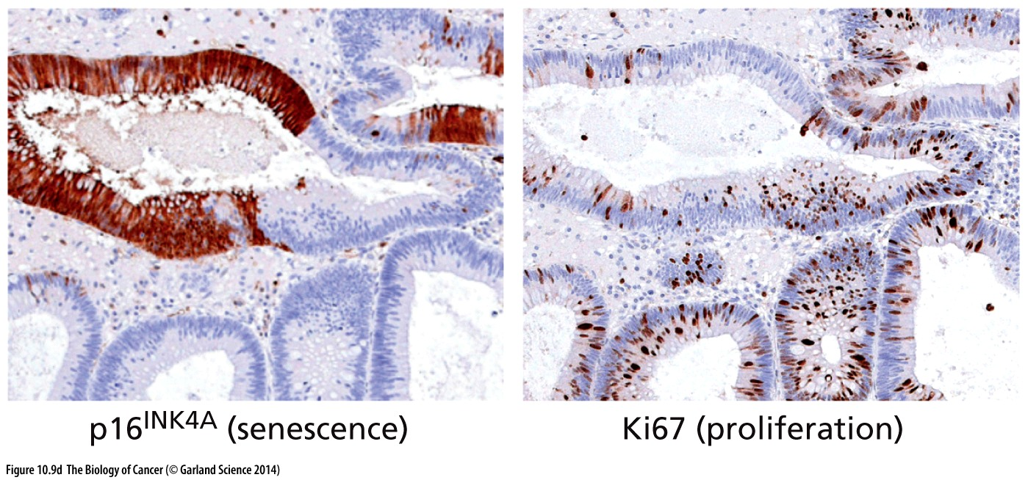
Figure 10.9 Evidence of senescent cells in living tissues
In human gastrointestinal tumors, cells with high levels of p16^{INK4A} (dark red, left) are largely not proliferating, as indicated by the pattern of expression of Ki67, a marker of proliferating cells.

Slide 25
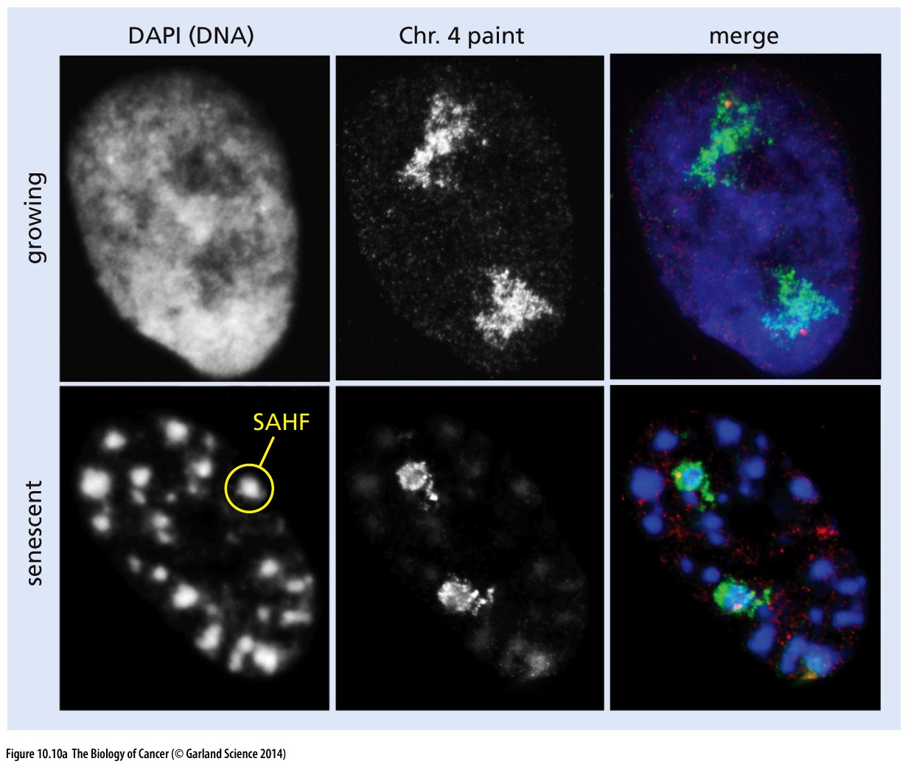
Figure 10.10 Senescence-associated foci
Senescence-associated heterochromatic foci (SAHFs) arise during senescence and derive from covalent modifications of the N- and C-terminal tails of histones within the nucleosomes
Notes:
细胞衰老的一些其他特征，如染色质结构改变，具体情况仅供参考

Slide 26
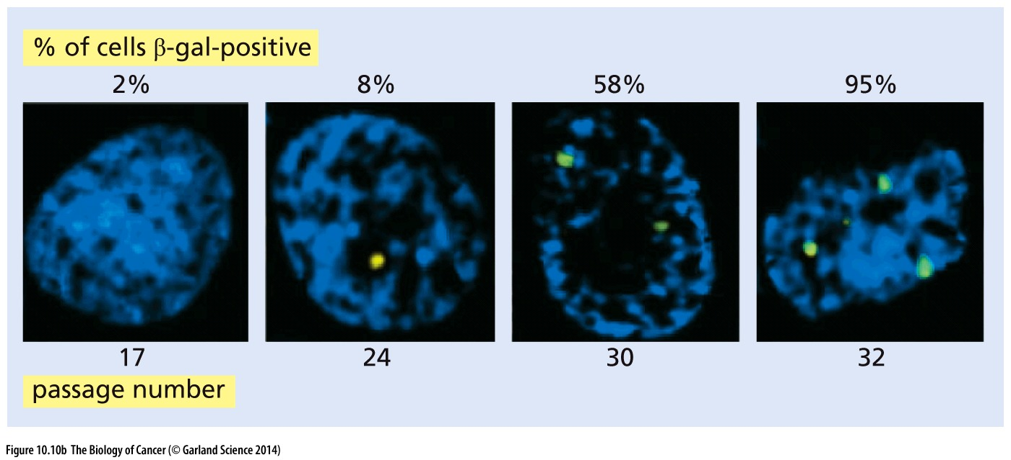
Figure 10.10 Senescence-associated foci
γ-H2AX foci(phosphorylation of histone H2AX, a variant of histone H2A), are normally formed in the chromatin flanking dsDNA breaks; in normal cells, these foci usually disappear in a matter of hours following successful DNA repair. However, the γ-H2AX foci (light green spots) that are detected in the nuclei (blue) of cultured senescent SA-β-gal–positive human fibroblasts persist and therefore appear to represent irreparable DNA breaks.
Notes:
细胞衰老往往伴随着不可修复的DNA损伤

Slide 27
Senescence and tumorigenesis
Generally, cellular senescence inhibit tumorigenesis
In some case, cellular senescence → release pro-inflammatory cytokines → promote tumorigenesis
Senescence
Pro-inflammatory cytokine
Tumorigenesis
Notes:
深入讲一下senescence 对肿瘤发生的影响，具体内容仅供参考。

Slide 28
10.4 The proliferation of cultured cells is also limited by the telomeres of their chromosomes

Slide 29
From primary cells to immortal cells
Primary cells—cells that have been prepared directly from tissues—actually confront two obstacles to their long-term proliferation in culture. The first of these is the replicative senescence that we described above; the second is crisis.
In the case of human embryonic kidney cells, as an example, expression of SV40 large T oncoprotein enables bypass of the first hurdle—senescence (see Figure 10.8)— but it will fail to immortalize these cells. Thus, after an additional number of cell generations—perhaps 10 to 20—beyond the time when they would usually senesce, cell populations enter into crisis and exhibit widespread apoptosis. The SV40 large T antigen, even with its potent p53-inactivating ability, clearly does not protect against the apoptotic death associated with crisis.

Slide 30
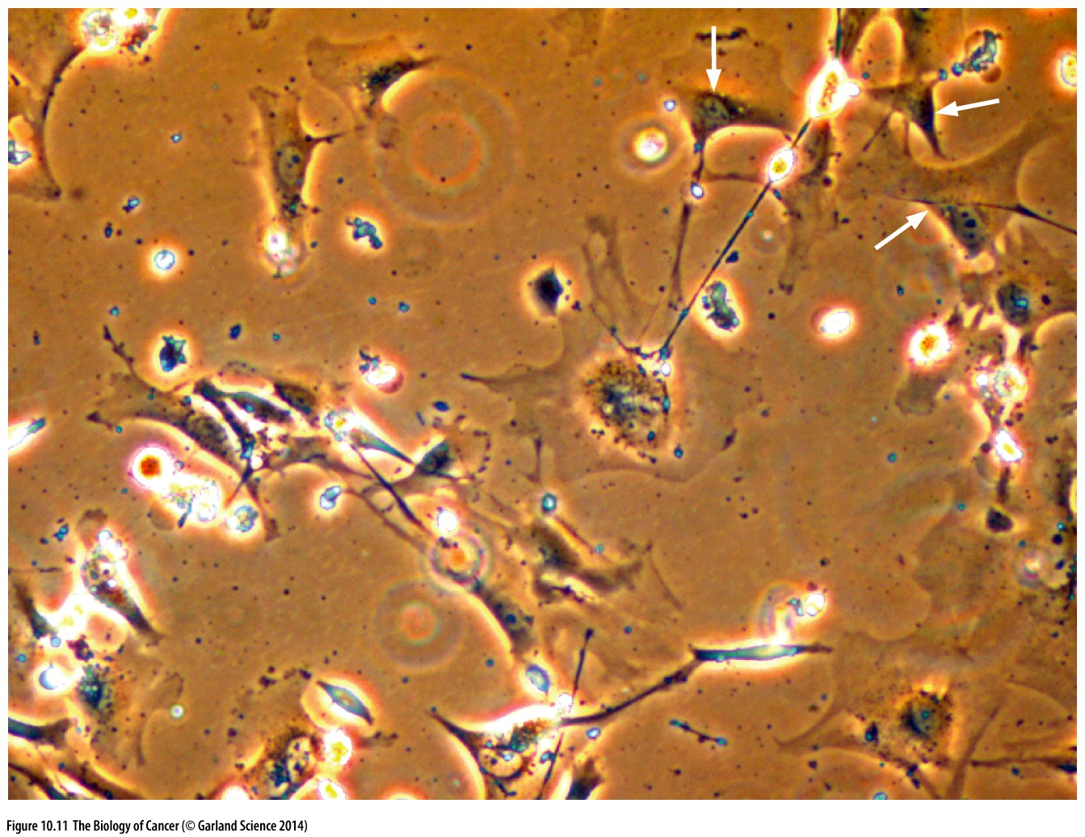
Figure 10.11 Apoptosis associated with cell populations in crisis
Cell populations in crisis show widespread apoptosis, with a high percentage of cells in the midst of disintegrating and numerous cell fragments (white refractile spots). Because populations of cells enter into crisis asynchronously, some of the cells in such populations still appear relatively normal (arrows, top right).

Slide 31
Linear DNA problems and Telomere（端粒）
Linear DNA problems:
1, Easy to fuse with other linear DNA;
2, End-replication problem;
Telomere is a region of repetitive nucleotide sequences at each end of a chromosome, which protects the end of the chromosome from deterioration or from fusion with neighboring chromosomes.

Slide 32
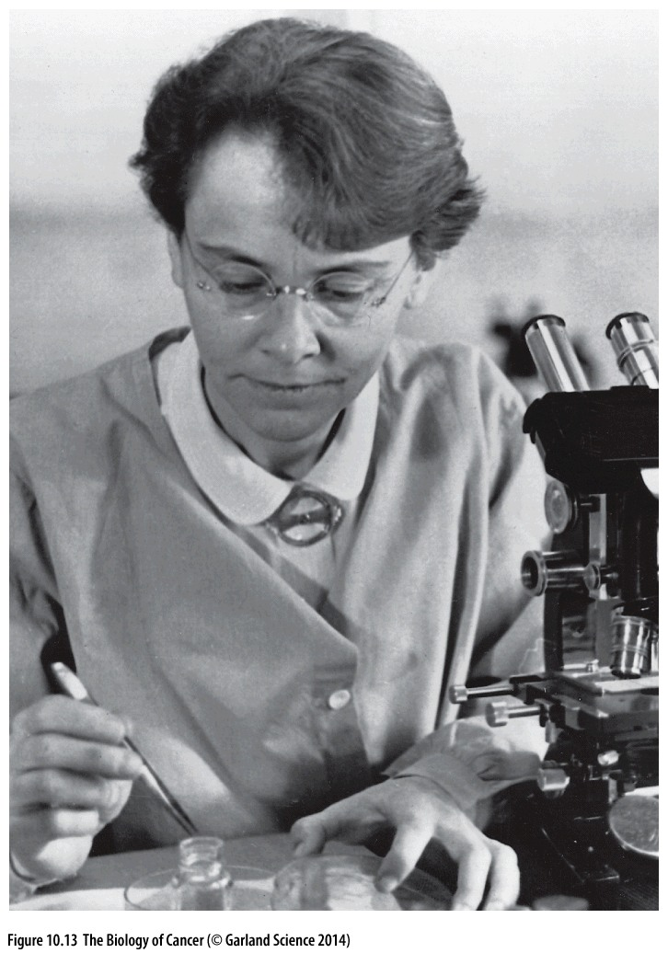
Barbara McClintock(June 16, 1902 – September 2, 1992)
Barbara McClintock’s detailed studies of the chromosomes of corn (maize) revealed specialized structures at the ends of chromosomes—the telomeres—that protected them from end to- end fusions. This work, and her demonstration of movable genetic elements in the corn genome, later called transposons, earned her the Nobel Prize in physiology or Medicine in 1983.
Notes:
Barbara McClintock propose the existence of telomere in 1930s，是一位极有远见的科学家！ she was the only woman to receive an unshared Nobel Prize in Physiology or Medicine

Slide 33
Telomere, telomerase and cell aging
In the early 1970s, Russian theorist Alexei Olovnikov first recognized that chromosomes could not completely replicate their ends. Building on this, and to accommodate Leonard Hayflick's idea of limited somatic cell division, Olovnikov suggested that DNA sequences are lost every time a cell/DNA replicates until the loss reaches a critical level, at which point cell division ends. However, Olovnikov's prediction was not widely known except by a handful of researchers studying cellular aging and immortalization.
In 1975–1977, Elizabeth Blackburn, working as a postdoctoral fellow at Yale University with Joseph Gall, discovered the unusual nature of telomeres, with their simple repeated DNA sequences composing chromosome ends. Blackburn, Carol Greider, and Jack Szostak were awarded the 2009 Nobel Prize in Physiology or Medicine for the discovery of how chromosomes are protected by telomeres and the enzyme telomerase.

Slide 34
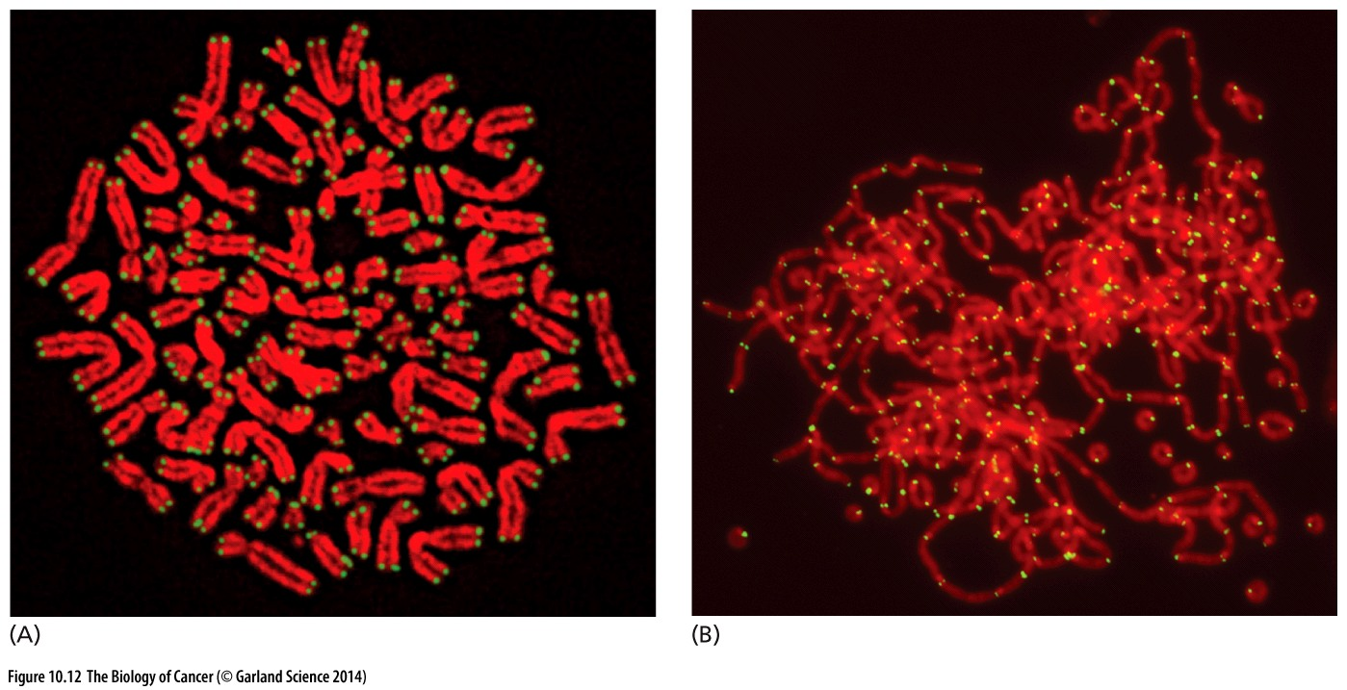
Figure 10.12 Telomeres detected by fluorescence in situ hybridization
WT TRF2^{-/-}
The karyotype seen in panel A can be compared with that of cells that have been deprived of TRF2, a key protein in maintaining normal telomere structure (see Figure 10.19). In these cells, the telomeres lose their protective function, resulting in end-to-end fusions of all the chromosomes of a cell into one huge chromosome.
Telomeres can be detected by the technique of fluorescence in situ hybridization (FISH), in which a DNA probe that recognizes the repeated sequence present in telomeric DNA is coupled with a fluorescent label.

Slide 35
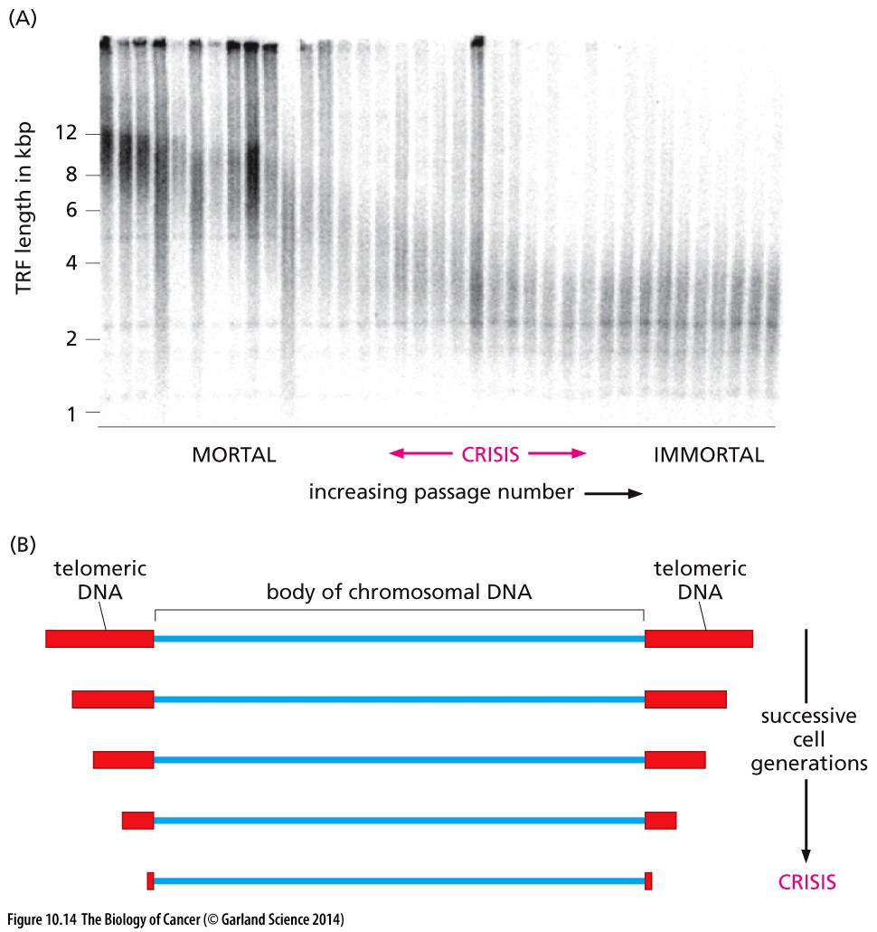
Figure 10.14 Shortening of telomeric
DNA in concert with cell proliferation
telomeric restriction fragments (TRFs).
Southern blotting analysis using a probe
that recognizes the TTAGGG sequence.
Telomeres may lose their protective function when their regions of pure TTAGGG repeats have eroded down to a length of ~12 repeats. Note that this drawing is not to scale: telomeric DNA is usually 5 to 10 kbp long, while the body of chromosomal DNA (blue) is tens to hundreds of megabase pairs (Mbp) long.
Notes:
端粒与细胞衰老，个体衰老

Slide 36
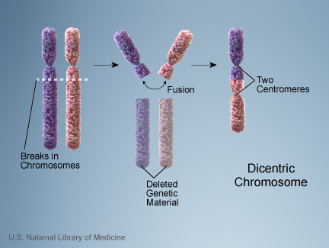
Breakage–fusion–bridge (BFB) cycles
The consequence of telomere loss is Breakage–fusion–bridge cycles, involves the initial breakage of dicentric (双着丝粒) chromatids in anaphase, the subsequent fusion of the resulting atelomeric DNA ends with yet other chromatids, and the formation once again of anaphase bridges by the new dicentric chromosomes resulting from these fusions (Figure 10.16). While they are occurring, these BFB cycles create karyotypic chaos that has the potential to affect many chromosomes within a cell.
BFB cycle was first proposed by McClintock
Notes:
端粒缺失密切相关的染色体异常表现

Slide 37
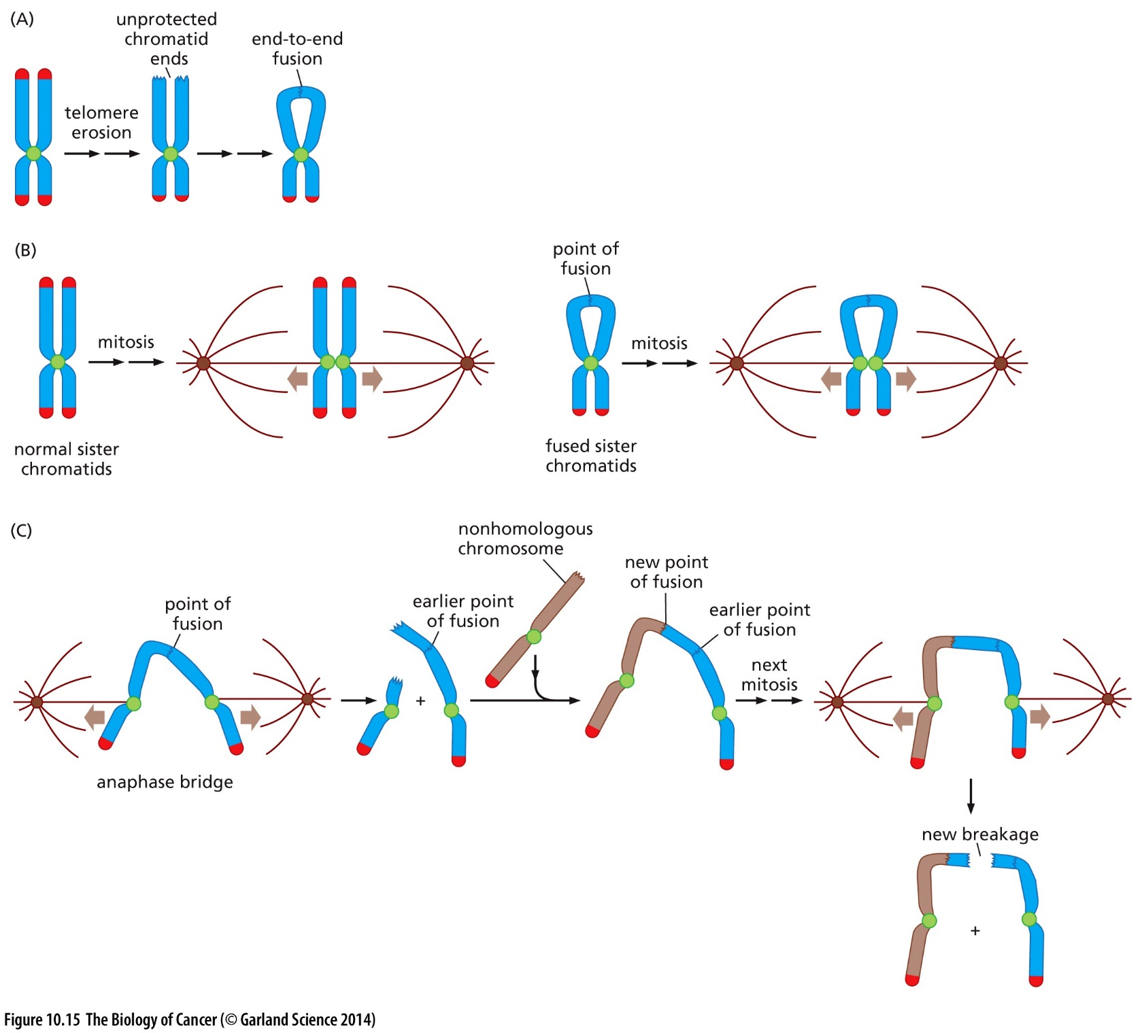
Figure 10.15 Mechanisms of breakage–fusion–bridge cycles
Notes:
Note that the karyotypic instability occurring during crisis, which has been termed “genetic catastrophe,” is so severe that apoptosis occurs even in the absence of p53 function.

Slide 38
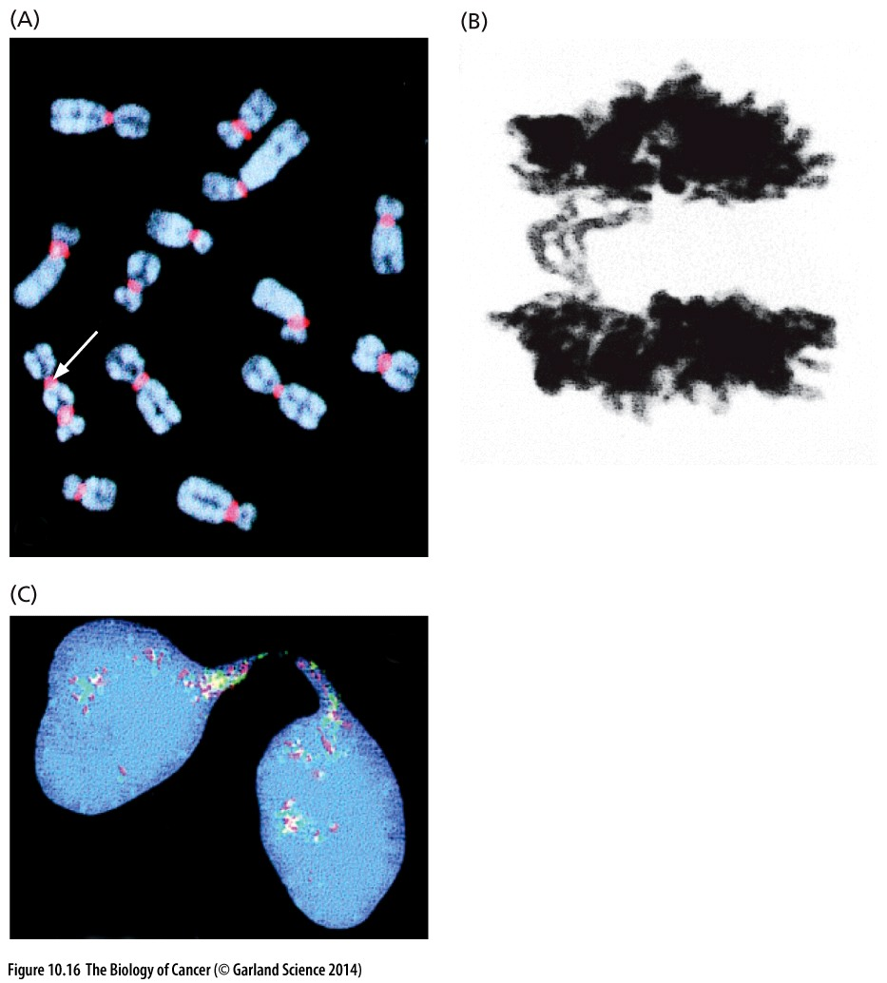
Figure 10.16 Dicentric chromosomes, anaphase bridges, and internuclear bridges
(A) A dicentric chromosome is seen (white arrow) in a metaphase spread of cells from a human pancreatic carcinoma cell line.
(B) Such dicentric chromosomes often result in the formation of anaphase bridges. Observation of such anaphase bridges provides strong evidence that chromosomes within such cells are participating in breakage–fusion–bridge cycles because they no longer possess adequate telomeres.
(C) While most anaphase bridges are broken during telophase or cytokinesis, some may persist in the resulting interphase cells.
Notes:
端粒丢失的后果

Slide 39
10.5 Telomeres are complex molecular structures that are not easily replicated
end-replication problem
Notes:
Telomere的具体结构

Slide 40
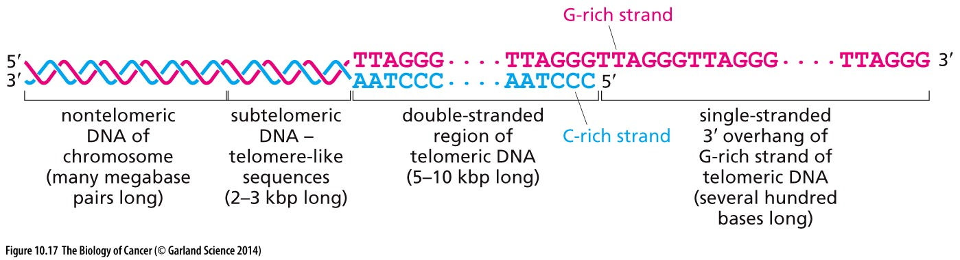
Figure 10.17 The 3ʹ overhang of telomeric DNA
This overhanging strand is often found in a most unusual molecular configuration termed the t-loop. It was discovered in the late 1990s with electron microscopy.

Slide 41
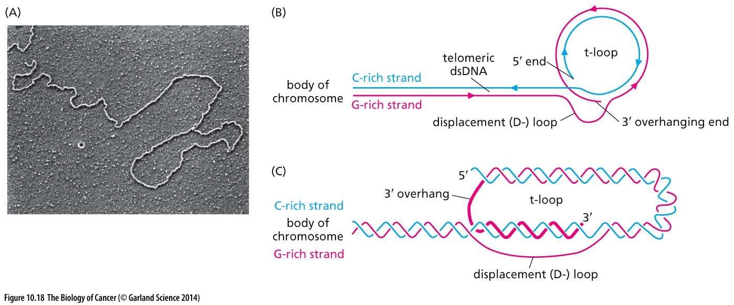
Figure 10.18 Structure of the t-loop
(A) Purification of telomeric DNA from mouse cells reveals, upon electron microscopy, lariats（套索）, called t-loops, at the ends of chromosomal DNA.
(B) This drawing of the t-loop indicates that the 3ʹ overhanging end of the G-rich strand (pink) is annealed to a small region of the C-rich strand (blue), causing the formation of a displacement (D-) loop (pink strand).
(C) The t-loop is illustrated once again, on this occasion with the double helices drawn and the 3ʹ overhanging end emphasized in a heavier pink line.
Notes:
端粒DNA的结构

Slide 42
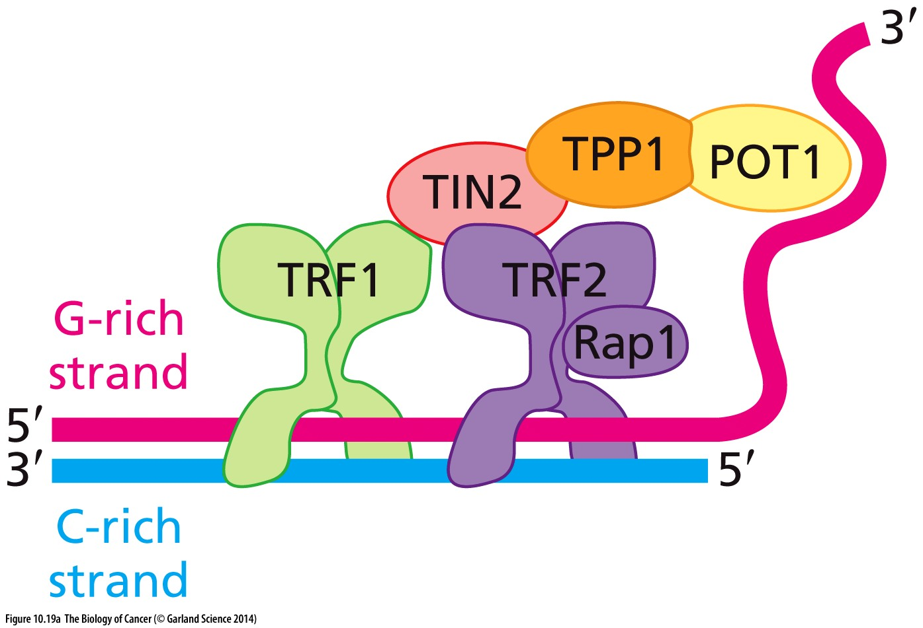
Figure 10.19 Multiple telomere specific proteins bound to telomeric DNA
(A) In addition to its complex structure, telomeric DNA is protected from degradation by a group of physically associated proteins that constitute the shelterin complex. Two of the latter’s proteins—TRF1 and TRF2—bind to the double-stranded DNA portion of telomeres while a third protein—POT1—binds to both the single-stranded 3ʹ overhang created by the G-rich strand and the ssDNA in the displacement (D-) loop.
Notes:
很多结合蛋白，具体内容仅供参考

Slide 43
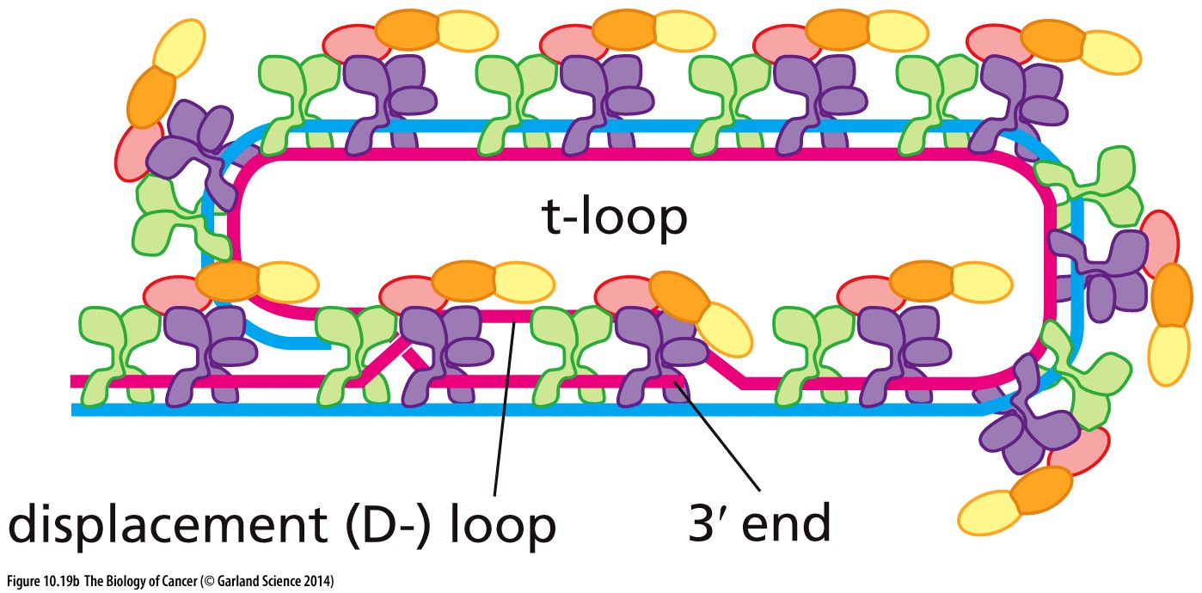
Figure 10.19 Multiple telomere specific proteins bound to telomeric DNA
(B) The shelterin complex is present in multiple copies per telomere and is responsible, in part, for maintaining the structure of the t-loop. As is indicated here, by binding to the D-loop, POT1 is able to stabilize this structure and thus the structure of the t-loop as a whole.
Notes:
具体内容仅供参考

Slide 44
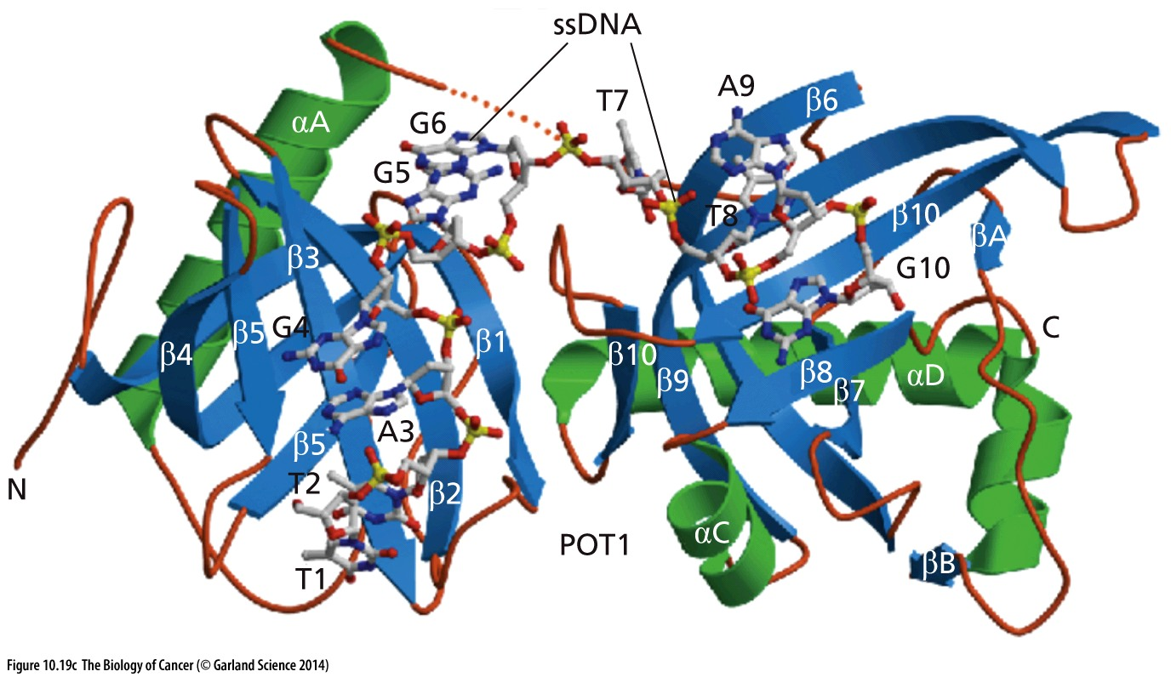
Figure 10.19 Multiple telomere specific proteins bound to telomeric DNA
(C) The molecular structure of human POT1 with its two ssDNA-binding domains is depicted as a ribbon diagram, with α-helices, β-pleated sheets, and loops numbered. The linker region between these two domains is disordered and represented by a dashed orange line. The binding by POT1 to single-stranded telomeric DNA (stick structure) helps to stabilize the D-loop.

Slide 45
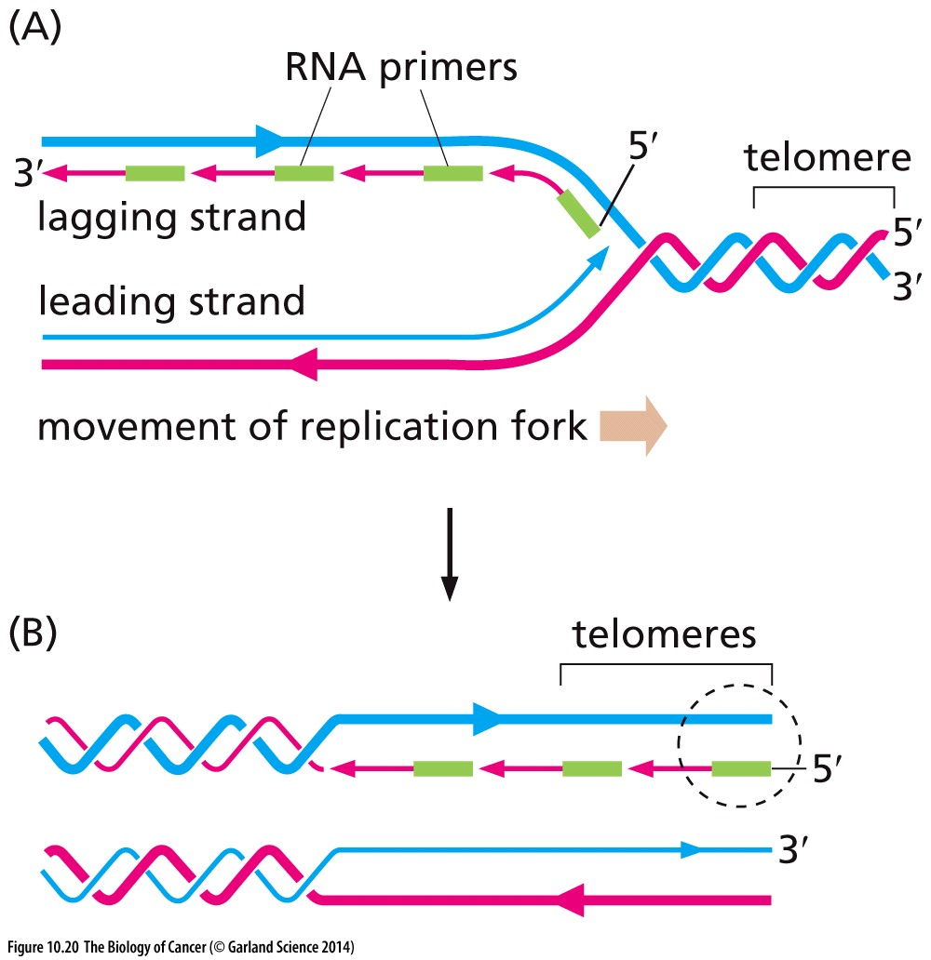
Figure 10.20 Primers and the initiation of DNA synthesis
End-replication problem

Slide 46
10.6 Incipient cancer cells can escape crisis by expressing telomerase

Slide 47
Telomerase in human cancer
A striking finding is that telomerase activity is clearly detectable in 85 to 90% of human tumor cell samples, while being present at very low levels in the lysates of most types of normal human cells, as measured by the TRAP assay (Figure 10.21）
Notes:
telomeric repeat amplification protocol (TRAP) assay

Slide 48
TERT Promoter Mutations in Human Melanoma
Highly recurrent TERT promoter mutations in human melanoma.
Huang FW, Hodis E, Xu MJ, Kryukov GV, Chin L, Garraway LA.
Science. 2013 Feb 22;339(6122):957-9.

Slide 49
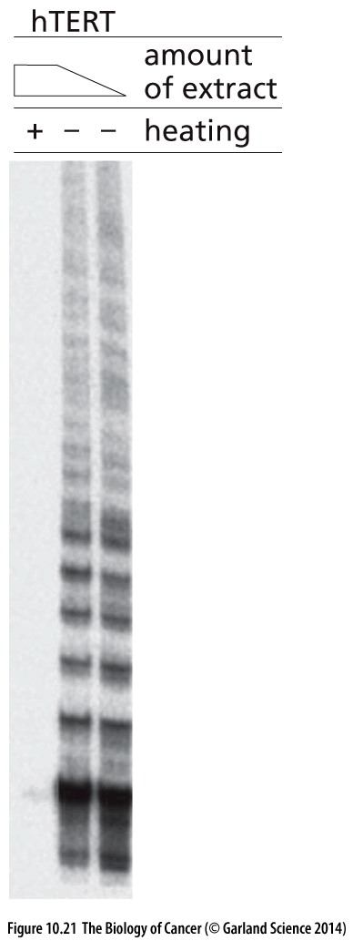
Figure 10.21 Detecting telomerase activity
The telomeric repeat amplification protocol (TRAP) assay permits detection of minute levels (微量) of telomerase activity in cell lysates by relying on the polymerase chain reaction (PCR) to amplify the products of the telomerase enzyme.

Slide 50
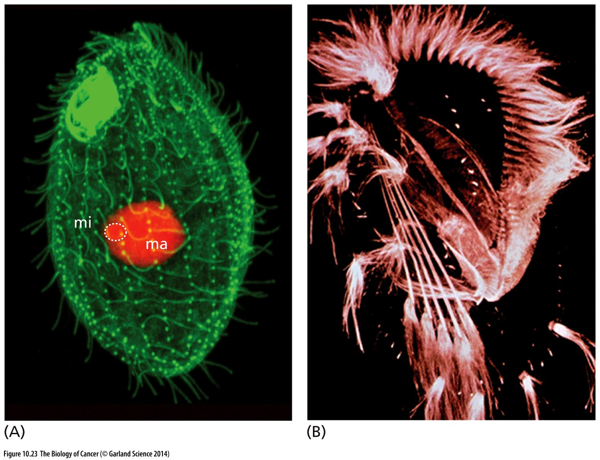
Figure 10.23 Ciliates(纤毛虫) and the isolation of the telomerase enzyme and gene
(A) Ciliates of the hypotrichous class have a large macronucleus and a small micronucleus. The former carries genes required for the maintenance of biosynthesis of these large cells, while the latter carries the germ-line copies of the genome. (B) The appearance of Euplotes aediculatus, from which the telomerase catalytic subunit was purified, yielding an amino acid sequence that allowed cloning of the encoding gene.
This organism carry hundreds of thousands of telomeres, while each human cell only contain 92 telomere
Notes:
端粒酶在正常分化的体细胞里面不表达，Elizabeth Blackburn首先用该纤毛虫研究端粒，是正确的选择。

Slide 51
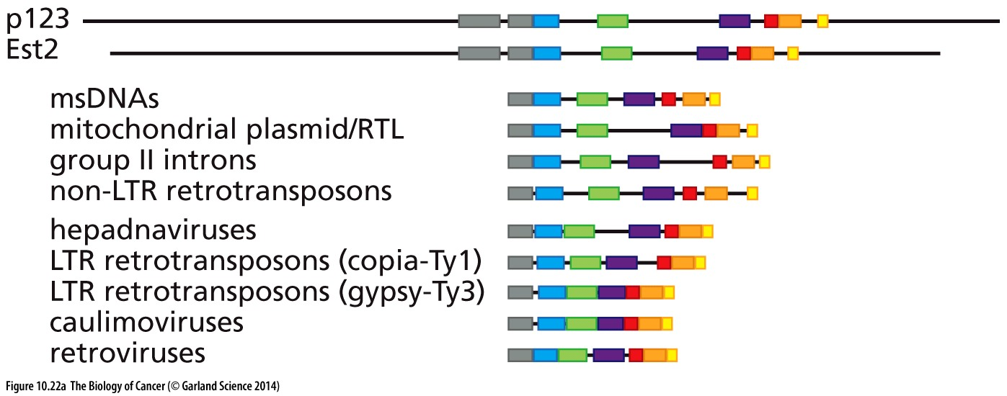
Figure 10.22 The catalytic subunit of telomerase
(A) Determination of the amino acid sequence of the catalytic subunit of the telomerase holoenzyme of Euplotes aediculatus (see Sidebar 10.3) enabled the cloning of the encoding gene, termed initially p123. This gene was found to be homologous to the gene encoding the catalytic subunit of the Saccharomyces cerevisiae (yeast) telomerase holoenzyme, termed Est2 (ever-shorter telomeres). Further analysis revealed extensive sequence relatedness of these two catalytic subunits to the catalytic clefts of reverse transcriptases (RTs) specified by a variety of retrotransposons as well as retroviruses such as human immunodeficiency virus (HIV).

Slide 52
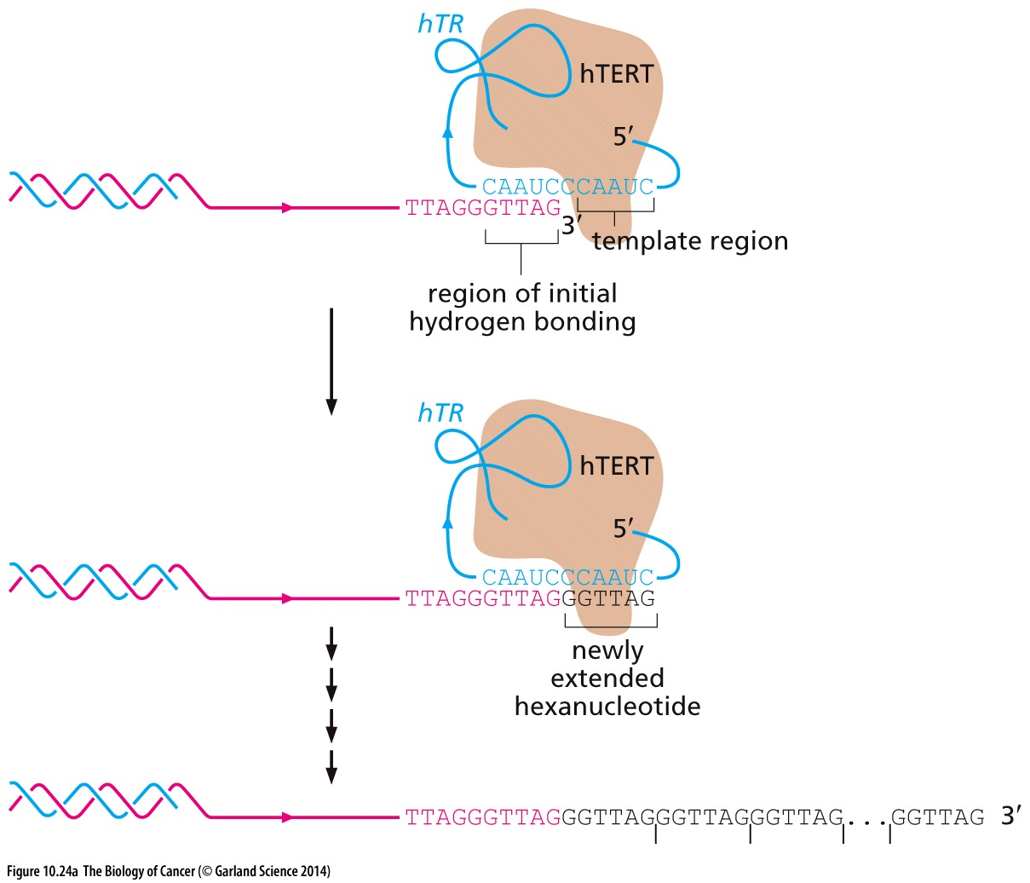
Figure 10.24 Structure of the human telomerase holoenzyme
(A) The human telomerase holoenzyme is composed of two core subunits, the hTERT catalytic subunit (light brown) and the associated hTR RNA subunit (blue). (Five other proteins, some present in two copies, are required to form a functional holoenzyme.) The holoenzyme attaches to the 3ʹ end of the G-rich strand overhang (pink), doing so in part through the hydrogen bonding of hTR to the last five nucleotides of the G-rich strand. Subsequently, by reverse transcription of sequences in the hTR subunit, hTERT is able to extend the G-rich strand by six nucleotides (black). By repeating this process in hexanucleotide increments (ticks), the enzyme can extend the G-rich strand by hundreds, even thousands of nucleotides, doing so in a processive fashion.

Slide 53
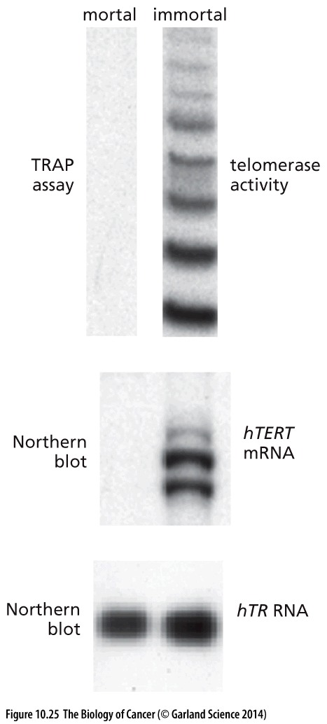
Figure 10.25 Activation of telomerase activity following escape from crisis
The hTR RNA, which functions as a template for hTERT during telomeric DNA elongation (see Figure 10.24A), are increased only slightly (bottom).

Slide 54
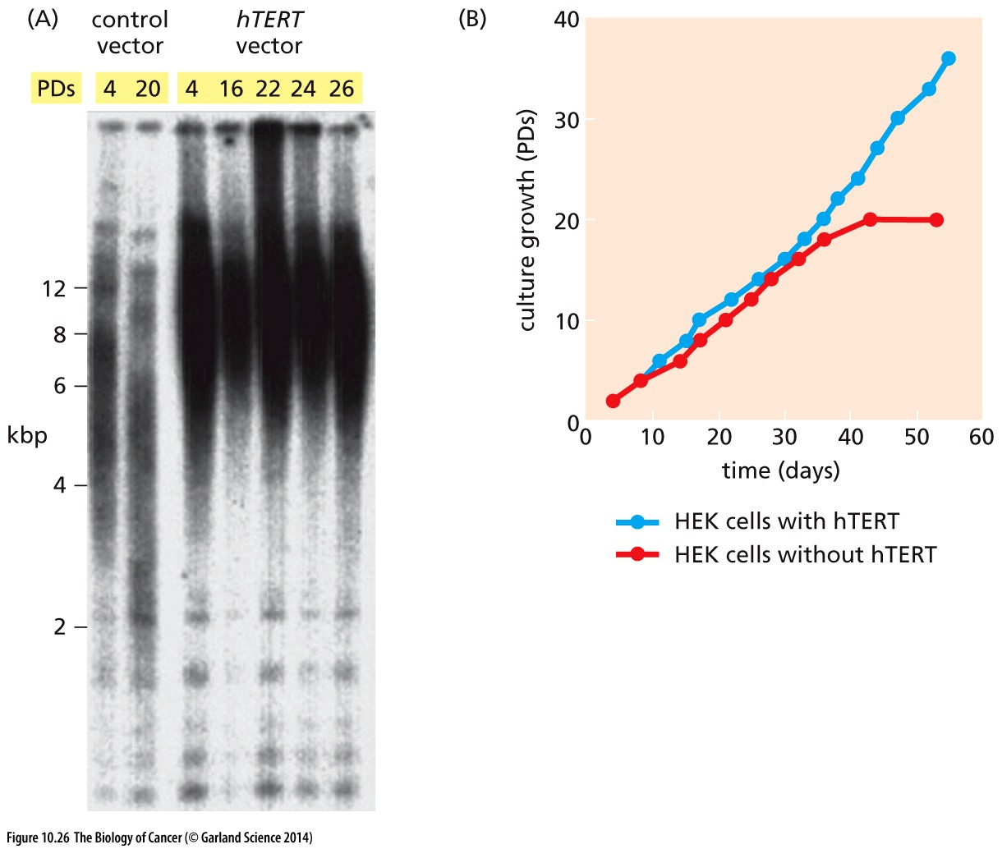
Figure 10.26 Prevention of crisis by expression of telomerase
(A) This Southern blot reveals the lengths of telomeric DNAs that were generated by cleaving genomic DNA with a restriction enzyme that does not cut within the repeating hexanucleotide sequence of telomeres

Slide 55
10.7 Telomerase plays a key role in the proliferation of human cancer cells

Slide 56
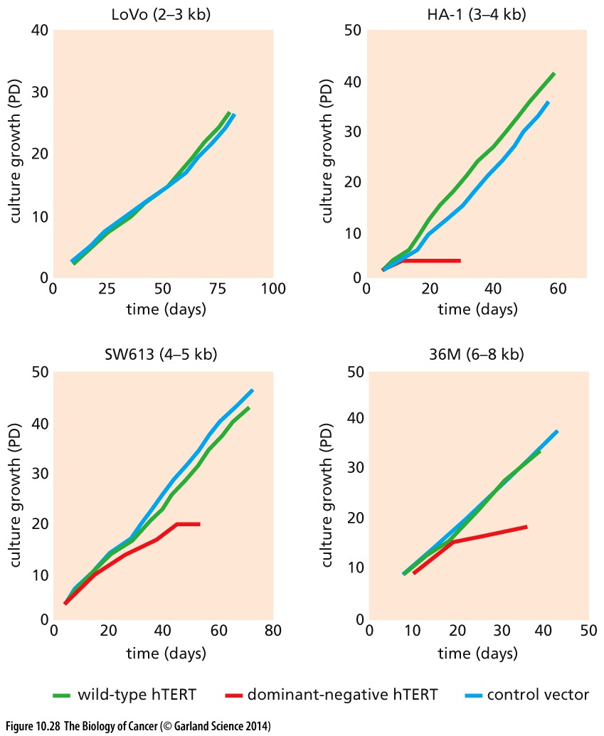
Figure 10.28 Suppression of telomerase activity and resulting loss of the neoplastic growth program
Cells of the LoVo cell line (top left) entered crisis immediately after expressing the dn hTERT enzyme, and therefore no cells were available to count.

Slide 57
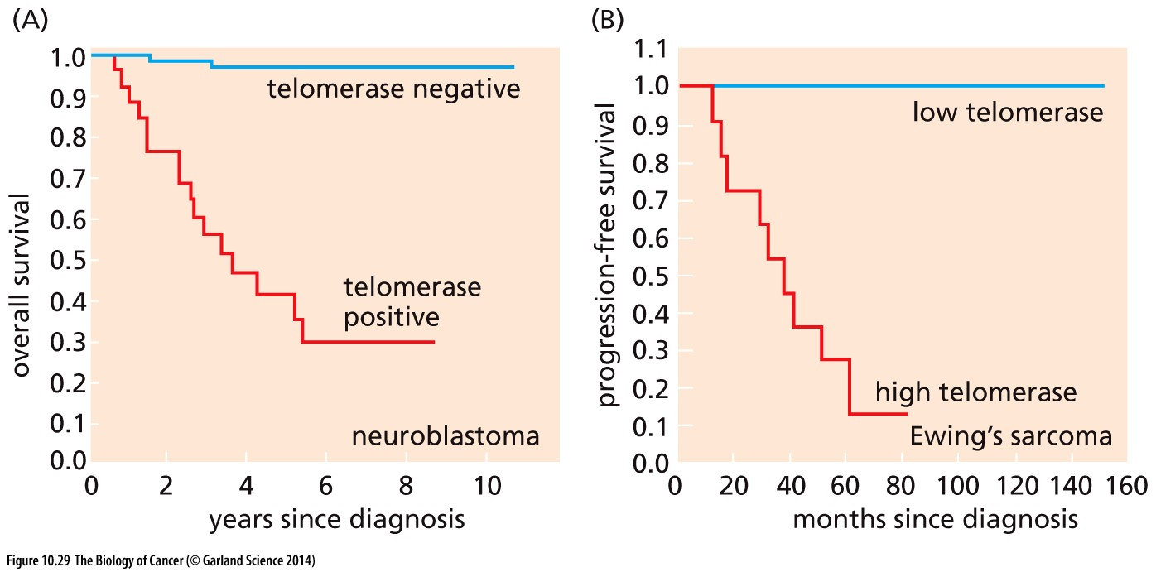
Figure 10.29 Telomerase activity and the prognosis of pediatric tumors
(A) This Kaplan–Meier plot illustrates the survival of a group of pediatric neuroblastoma patients who had received no cytotoxic chemotherapy treatment and who were tracked for the time spans indicated (abscissa) following diagnosis. The ordinate indicates overall survival, i.e., the proportion of patients who remained alive at various times after diagnosis. (B) A similar study of children with Ewing’s sarcoma was undertaken, In this case, the ordinate indicates the proportion of children who experienced progression-free survival, i.e., those whose tumors had not advanced beyond the stage initially encountered in the clinic.

Slide 58
10.8 Some immortalized cells can maintain telomeres without telomerase
85 to 90% of human tumors have been found to be telomerase-positive. The remaining 10 to 15% lack readily detectable telomerase enzyme activity, these tumor cells use telomerase independent mechanism to maintain telomeres
Notes:
生物体总是复杂的！端粒酶活性并不是维护端粒的唯一机制。具体机制仅供参考

Slide 59
Alternative lengthening of telomeres (ALT) mechanism
This non-telomerase-based mechanism was first discovered in the yeast following inactivation of one of the several yeast genes encoding subunits of its telomerase holoenzyme. Resulting mutant yeast cells soon entered into a state that is analogous to crisis in mammalian cells. The vast majority of the cells died, but rare variants emerged from these populations of dying cells that used the ALT (alternative lengthening of telomeres) mechanism, which is telomerase-independent, to construct and maintain their telomeres.

Slide 60
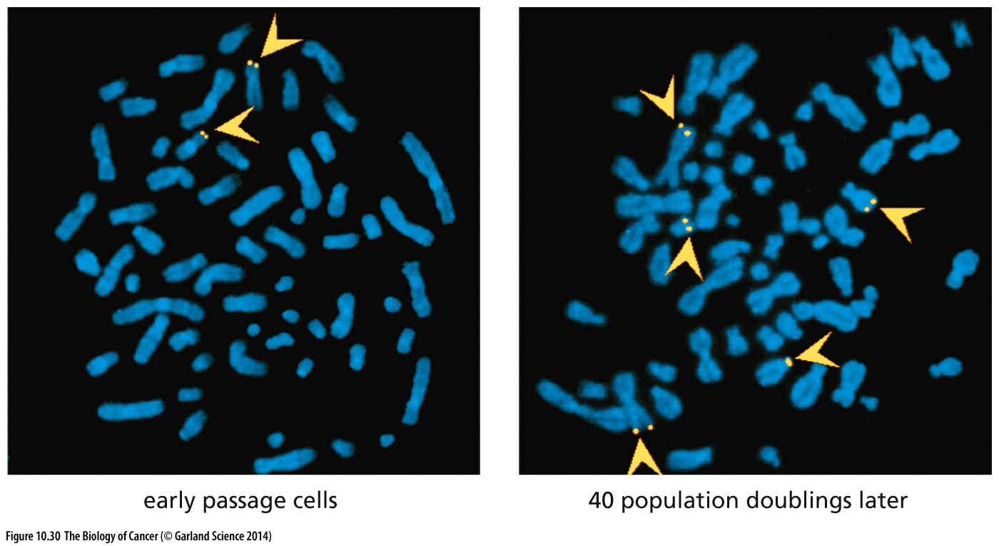
Figure 10.30 The ALT mechanism
The alternative lengthening of telomeres (ALT) mechanism can be shown to depend, at least in certain cells, on the exchange of sequence information between the telomeres of different chromosomes. Here, telomeres of human GM847 cells were labeled via the targeted insertion of a genetic marker into one of the telomeres. By the time of the analysis, the marker was already present in two telomeres (arrowheads, left panel). Forty population doublings later, this sequence could be found to be associated with five distinct chromosomes (arrowheads, right panel). Fluorescence in situ hybridization (FISH) was used to detect these marker sequences in metaphase chromosomal preparations.
Notes:
Telomerase不能解释这种异位telomere扩增，因而必定存在telomerase非依赖的telomere 扩增方式

Slide 61
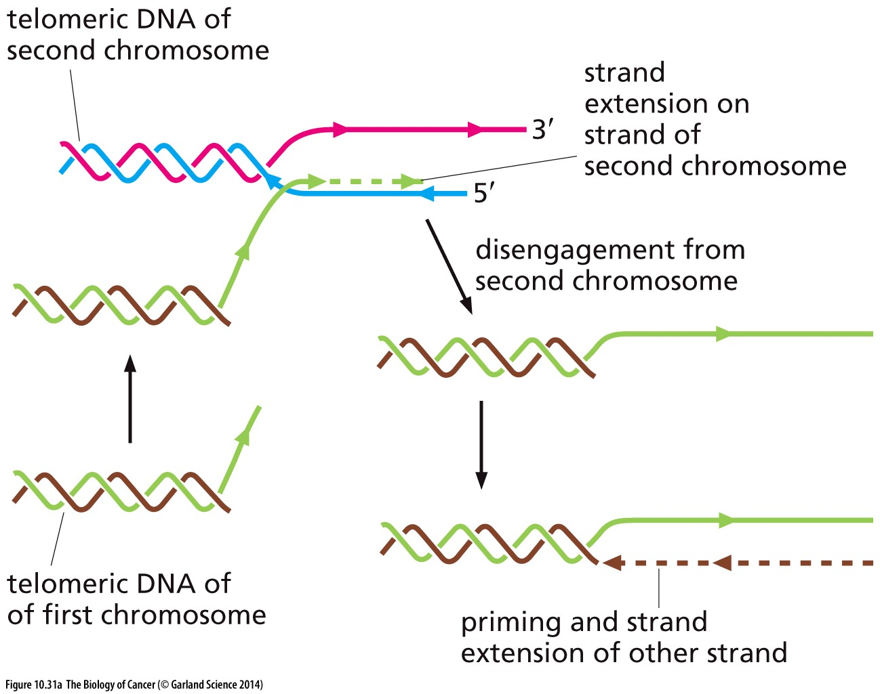
Figure 10.31 Alternative mechanisms supporting ALT
(A) One possible mechanism of telomere maintenance in ALT cells involves the exchange of sequence information between telomeres (see Figure 10.30), which may in turn depend on DNA polymerases that use more than one chromosome as a template during chromosome replication.

Slide 62
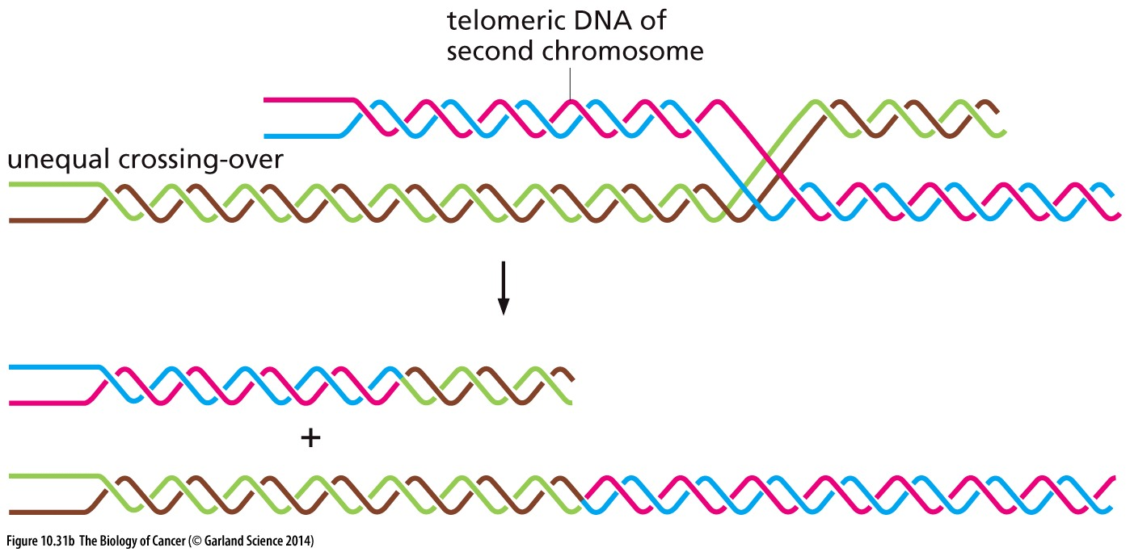
Figure 10.31 Alternative mechanisms supporting ALT
(B) It is also possible that telomeres may exchange sequence segments through the mechanism of unequal crossing-over, which results in this case in one telomere of increased length and another of decreased length.
Notes:
第二种可能的ALT 机制，仅供参考

Slide 63
10.9 Telomeres play different roles in the cells of laboratory mice and in human cells
Mouse life span: ~3years
Human life span: ~100years
Mouse telomeric DNA: 30 to 40 kb
Human telomeric DNA: 5 to 8kb
Laboratory mice do not rely on telomere length to limit the replicative capacity of their normal cell lineages and that telomere erosion cannot serve as a mechanism for constraining tumor development in these rodents.
Primary mouse cells can be transformed with Large T;
Primary human cells can be transformed with Large T + TERT;

Slide 64
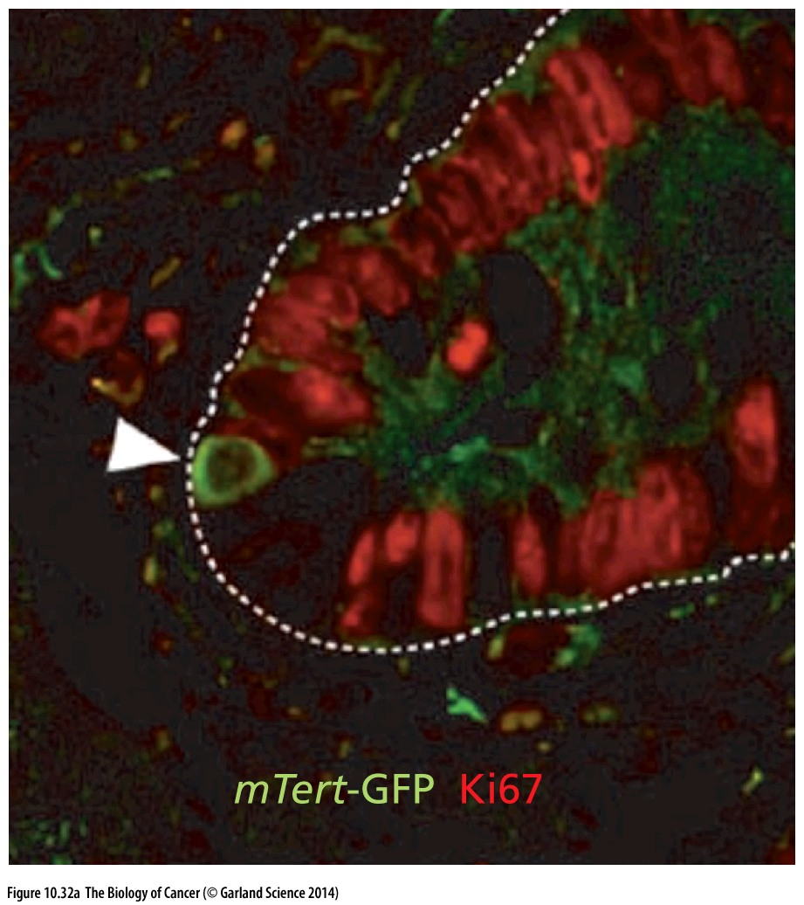
Figure 10.32 mTERT function may be confined largely to adult stem cells
Most of the mTERT activity in adult mice may be traceable to its expression in the stem cells of various tissues. (A) Transgenic mice were constructed in which the promoter of the mTERT gene drives expression of green fluorescent protein (GFP). In addition, cells in the crypts of the small intestine (see Figure 7.24) of these mice were immunostained with an antibody that recognizes Ki67, a marker of cells in the active growth-and-division cycle (red). This analysis indicates that the long-lived, slowly cycling cells in the crypt, which are located in the positions of stem cells (arrowhead), express readily detectable levels of mTERT while their more differentiated, rapidly proliferating progeny do not.

Slide 65
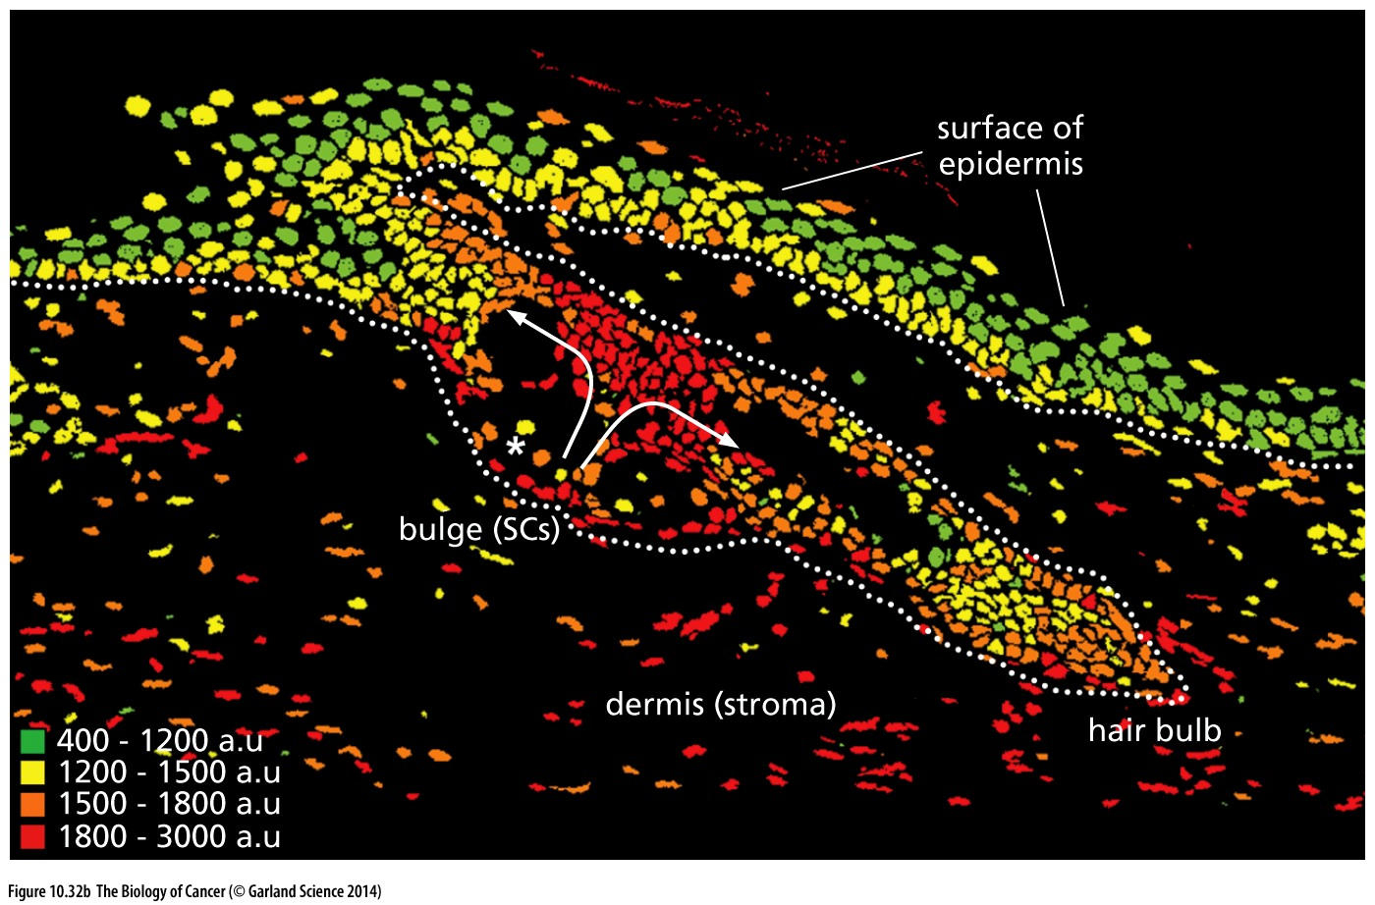
Figure 10.32 mTERT function may be confined largely to adult stem cells
(B) Fluorescence in situ hybridization (FISH) using a probe that is specific for telomeric DNA reveals that telomeres are longer in the stem cells than in their more differentiated progeny. These measurements translate to an average telomere length of ~43.9 ± 5.8 kb in the bulge region (in which stem cells, SCs, are concentrated) to 34.1 ± 3.2 in the interfollicular epidermis, i.e., the surface of the skin between hair roots.

Slide 66
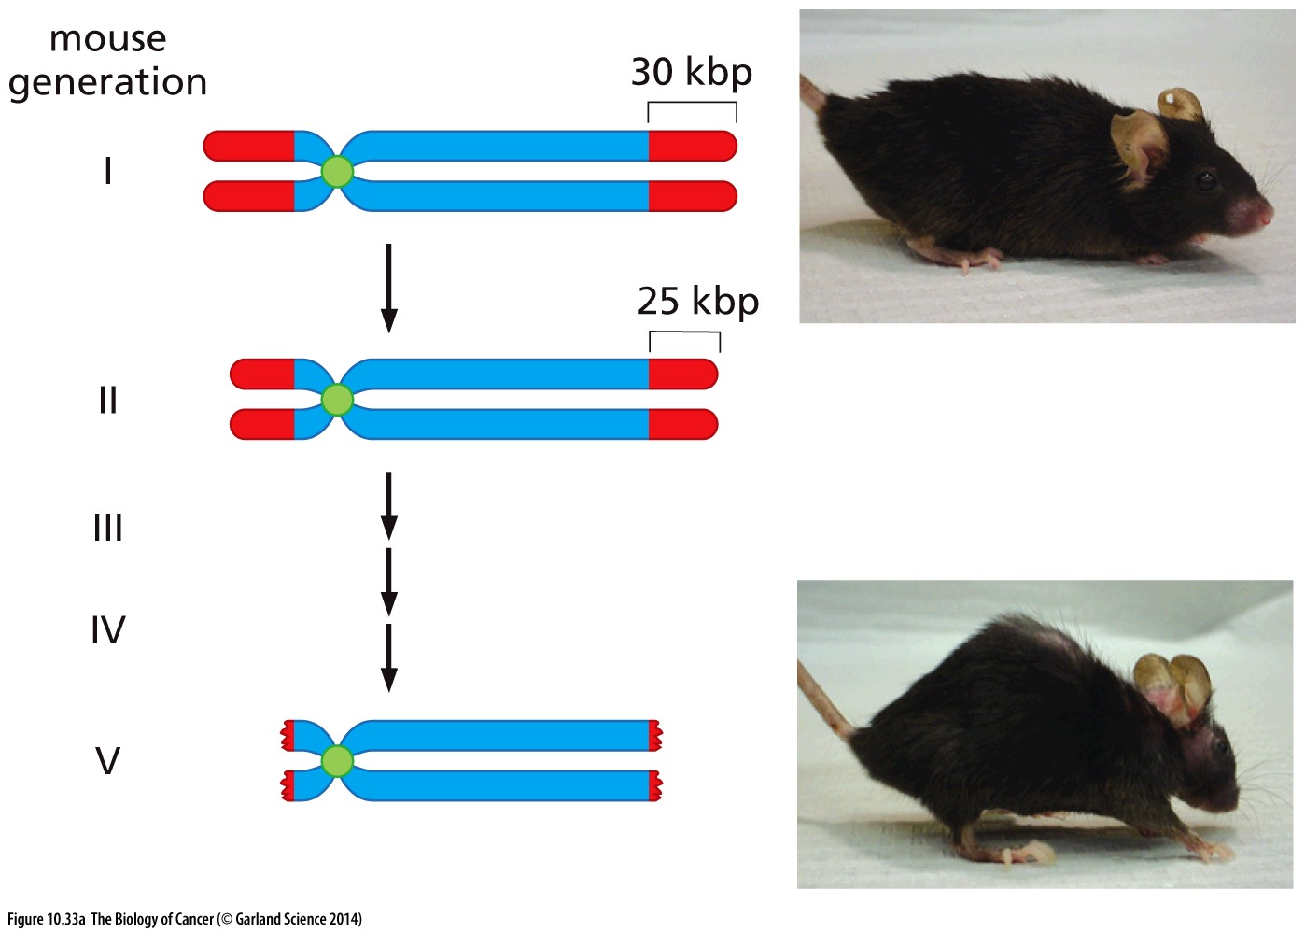
Figure 10.33 Erosion of telomeres over multiple generations in populations of mTR^{-/-} mice
(A) During the lifetimes of the first mTR–/– mouse generation, their telomeres, which are initially 30 kbp long (red), are reduced in size by about 5 kbp (left). These mice (top, right) are phenotypically normal, as are their descendants in the second and third generations. However, by the fifth organismic generation, the telomeres in their cells have eroded to the extent that they can no longer protect the ends of chromosomes; the tissues of these mice begin to lose their ability to renew themselves and heal wounds, and these mice begin to show symptoms of premature aging, including wasting away of muscle tissues and a hunched back（弓背） (bottom, right).

Slide 67
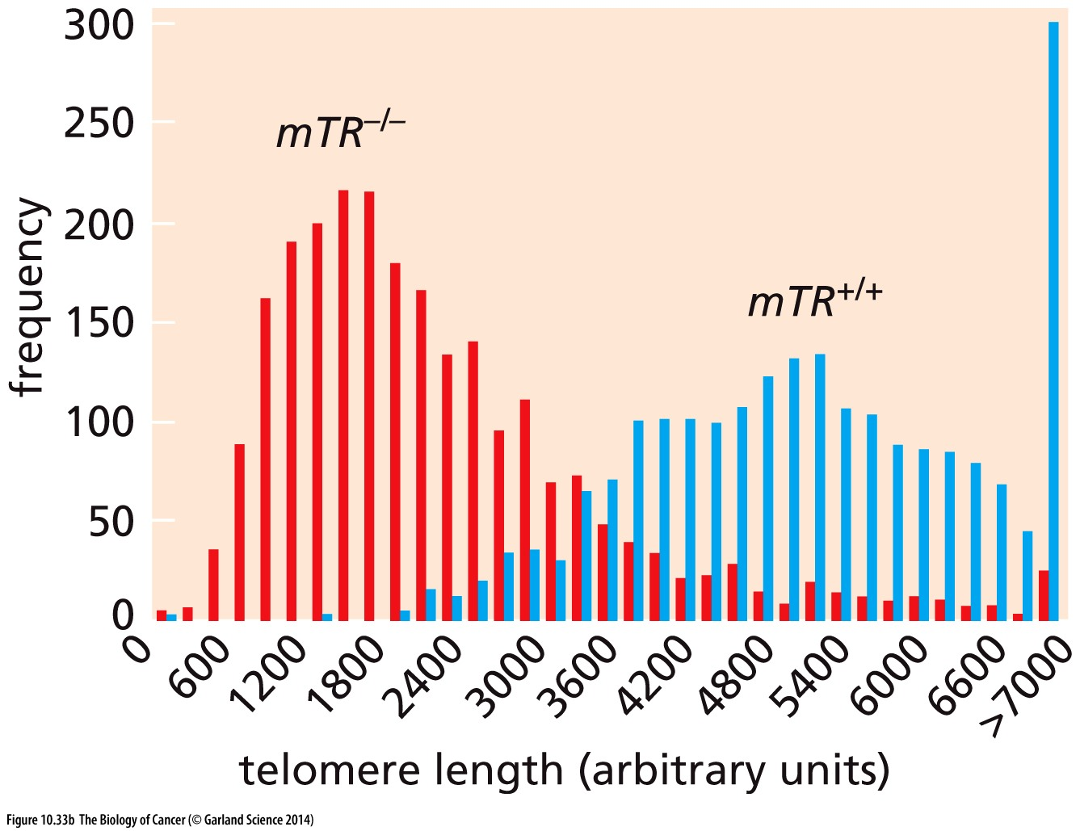
Figure 10.33 Erosion of telomeres over multiple generations in populations of mTR^{-/-} mice
(B) Telomere length can be gauged by fluorescent in situ hybridization (FISH) using a probe that is specific for the telomere repeat sequence.

Slide 68
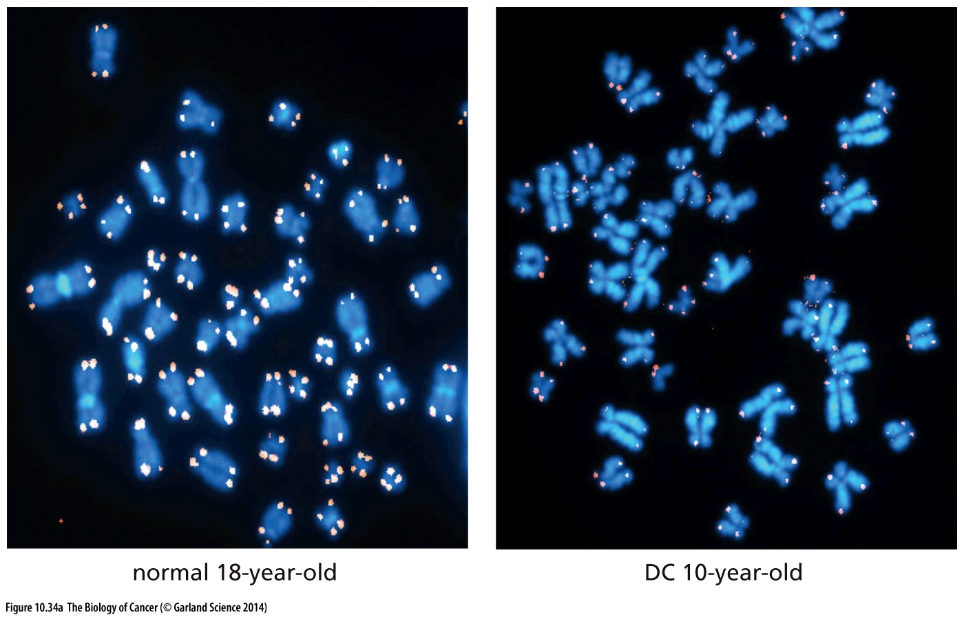
Figure 10.34 Telomere and bone marrow collapse of dyskeratosis congenita patients
Humans suffering from dyskeratosis congenita (DC) (先天性角化不良)experience atrophy of a number of tissues, which is traceable to the absence of functional telomerase and to the catastrophic collapse of their telomeres. (A) Fluorescence in situ hybridization (FISH) was used to detect the telomeres of metaphase chromosomes in a cell of a normal 18-year-old (left) as well as in a cell of a 10-year-old suffering from DC. Many of the chromosomes in the latter cell have telomeres that are so short that they are no longer detectable by FISH.
Dyskerin associates with the telomerase-associated RNA subunit (hTR) and helps hTR to assemble in the telomerase holoenzyme complex (see Figure 10.24).

Slide 69
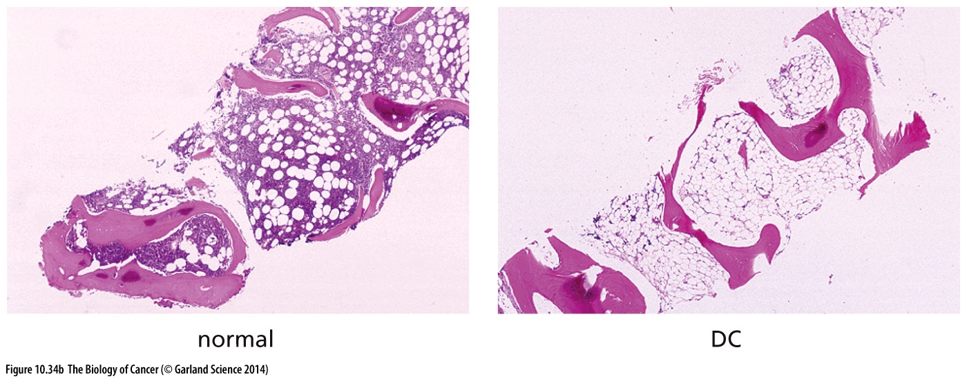
Figure 10.34 Telomere and bone marrow collapse of dyskeratosis congenita patients
(B) The most life-threatening tissue atrophy of DC patients occurs among the rapidly proliferating cells of the bone marrow.

Slide 70
Sidebar 10.9 Telomere collapse may contribute to cancer in organs affected by chronic inflammation In Chapter 11, we will read about a number of human tumors arising in tissues that suffer continuous loss of cells due to chronic infections or inflammation. Such ongoing attrition of cells, which may occur over a period of decades, occurs in tissues affected by, for example, ulcerative colitis, Barrett’s esophagus, and hepatitis B or C virus infection. In response to losses of differentiated cells, the stem cells in these tissues are continually producing replacements to ensure maintenance of tissue functions. These stem cells are therefore forced to pass through many more cycles of growth and division than are the corresponding stem cells of normal tissues. The resulting repeated cell cycles may tax the regenerative powers of the stem cell pools and lead eventually to telomere collapse, to the triggering of breakage–fusion–bridge cycles, and to the generation of karyotypes that favor neoplastic cell proliferation.
Inflammation → cell proliferation → telomere shortening →BFB cycle → anaphase bridges → genome instability
→ cancer

Slide 71
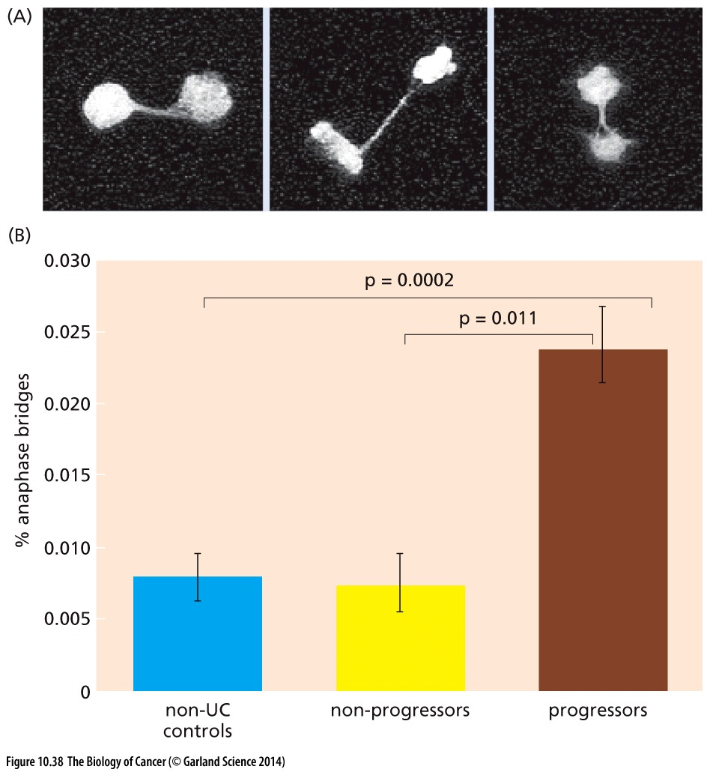
Figure 10.38 Ulcerative colitis(溃疡性结肠炎) and anaphase bridges
Ulcerative colitis (UC) involves chronic irritation and inflammation of the colonic epithelium. These provoke ongoing turnover of colonic epithelial cells that can continue for several decades. UC leads, with significant frequency, to the development of colon carcinomas.
Inflammation → cell proliferation → telomere shortening →BFB cycle → anaphase bridges → genome instability
→ cancer

Slide 72
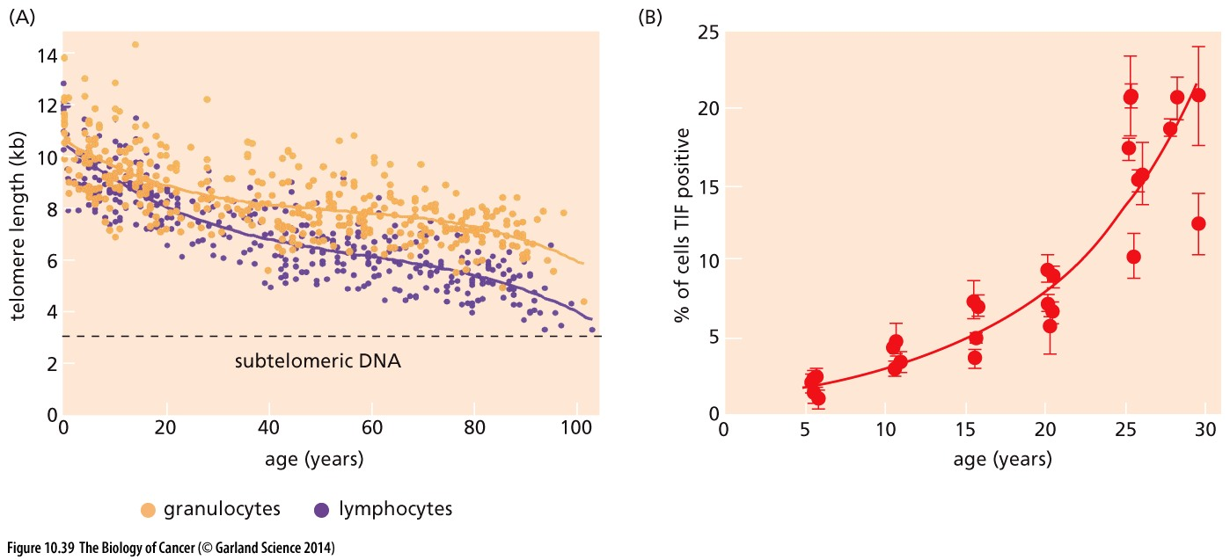
Figure 10.39 Telomere shortening, aging, and cancer
TIFs (telomere dysfunction–induced foci) were scored in dermal fibroblasts from baboons（狒狒） of various ages. These TIFs were scored wherever there was a congruence within a cell between γ-H2AX, a marker of double-strand DNA breaks (see Chapter 12), and telomeric DNA

Slide 73
课后作业
1. 简述Hayflick limit的意义、可能的机制，以及肿瘤细胞突破Hayflick limit的方法。
2. 简述breakage–fusion–bridge cycles的表现形式、发生原因以及后果。

